Slide 1
Major Bones

Slide 2
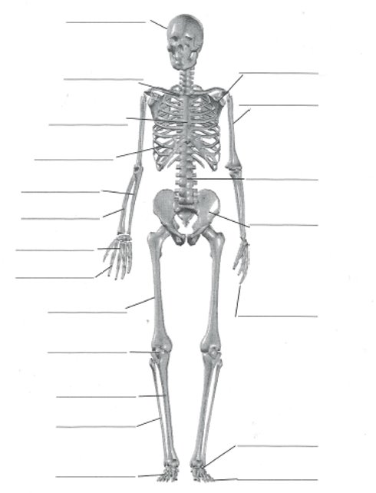

Slide 3
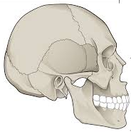

Slide 5
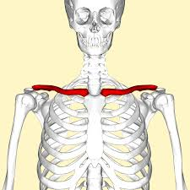

Slide 7
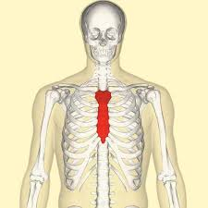

Slide 9
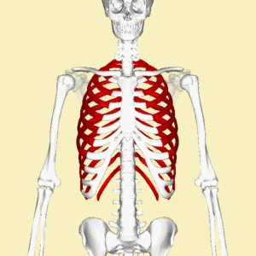

Slide 11
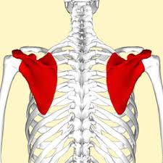

Slide 13
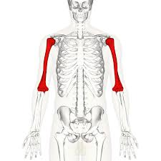

Slide 15
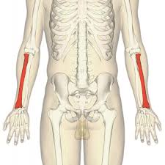

Slide 17
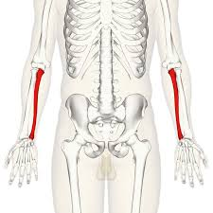

Slide 19
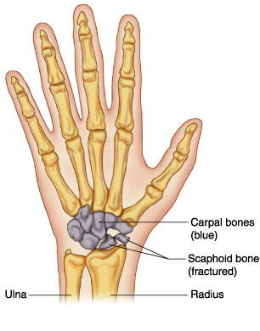

Slide 21
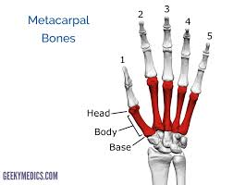

Slide 23
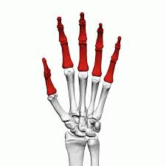

Slide 25
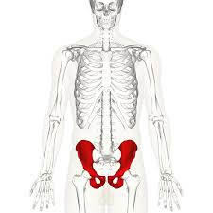

Slide 27
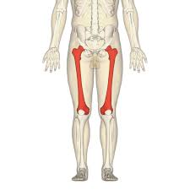

Slide 29
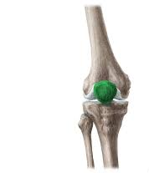

Slide 31
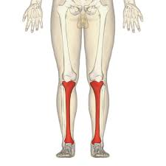

Slide 33
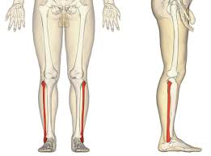

Slide 35
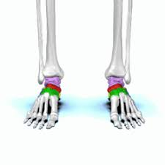

Slide 37
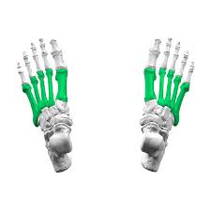

Slide 39
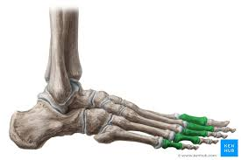

Slide 41
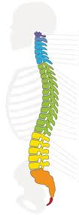

Slide 42
Vertebrae

Slide 43
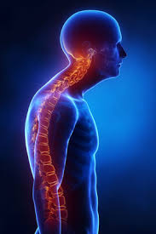
Postural Deviations

Slide 44
Postural Deviations

Slide 45
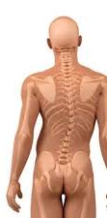
Postural Deviations

Slide 46
Postural Deviations

Slide 47
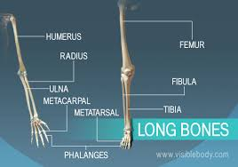
Type of Bones

Slide 48
Type:
Function:

Slide 49
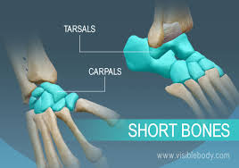
Type of Bones

Slide 50
Type:
Function:

Slide 51
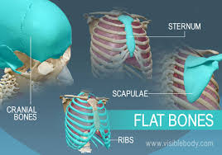
Type of Bones

Slide 52
Type:
Function:

Slide 53
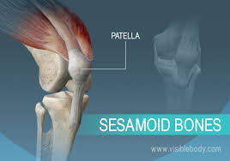
Type of Bones

Slide 54
Type:
Function:

Slide 55
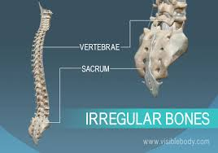
Type of Bones

Slide 56
Type:
Function:

Slide 57
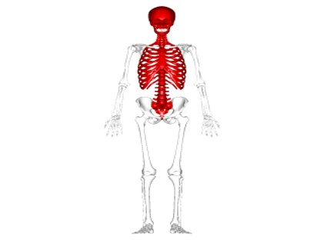
Areas of the Skeleton

Slide 59
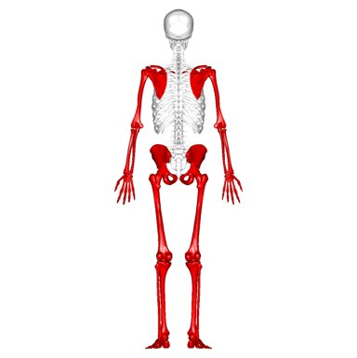
Areas of the Skeleton

Slide 61
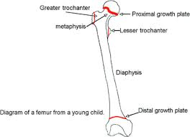
Process of Bone Growth
Bone growth is called:
Area where bone grows:

Slide 62
Bone growth is called:
Area where bone grows - also known as the growth plate:

Slide 63
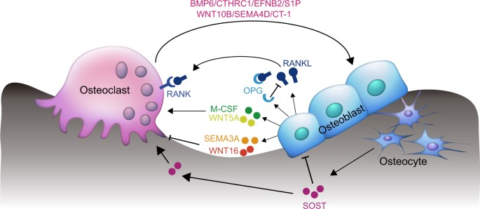
Process of Bone Growth is called…
?
?

Slide 64
Process of Bone Growth is called…
? Breaking done damaged bone and clearing it away.
? Building and forming new bone

Slide 65
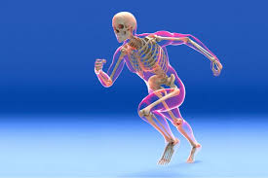
Functions of the Skeleton

Slide 66
Functions of the Skeleton

Slide 67
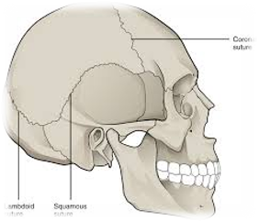
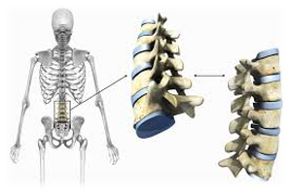
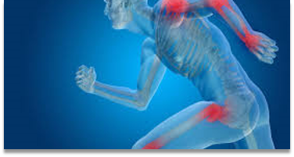
Joint Classification

Slide 68
Joint Classification

Slide 69
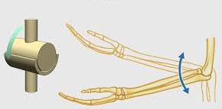
Types of Synovial Joints

Slide 70
Types of Synovial Joints
Type of Joint
Movements at joint

Slide 71
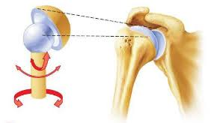
Types of Synovial Joints

Slide 72
Types of Synovial Joints
Type of Joint
Movements at joint

Slide 73
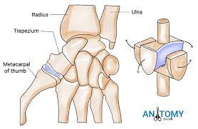
Types of Synovial Joints

Slide 74
Types of Synovial Joints
Type of Joint
Movements at joint

Slide 75
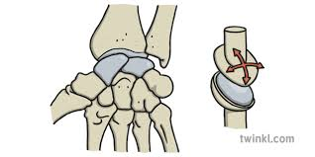
Types of Synovial Joints

Slide 76
Types of Synovial Joints
Type of Joint
Movements at joint

Slide 77
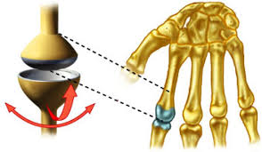
Types of Synovial Joints

Slide 78
Types of Synovial Joints
Type of Joint
Movements at joint

Slide 79
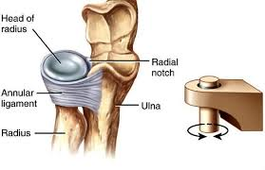
Types of Synovial Joints

Slide 80
Types of Synovial Joints
Type of Joint
Movements at joint

Slide 81
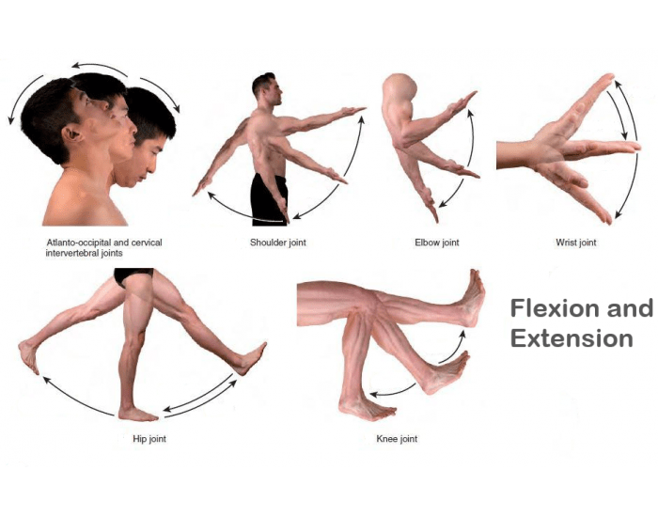
Types of movement

Slide 82
Types of movement

Slide 83
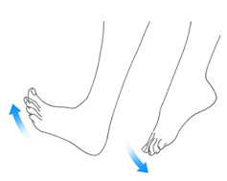
Types of movement

Slide 84
Types of movement

Slide 85
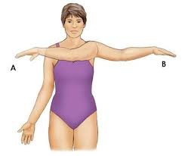
Types of movement

Slide 86
Types of movement
A
B

Slide 87
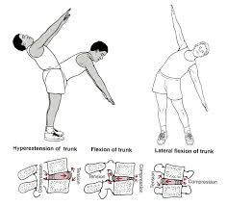
Types of movement

Slide 88
Types of movement
Leaning back
Bending sideways

Slide 89
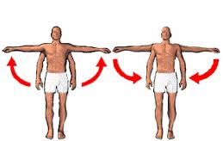
Types of movement

Slide 90
Types of movement

Slide 91
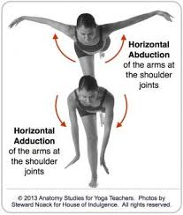
Types of movement

Slide 92
Types of movement

Slide 93
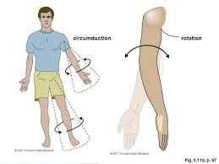
Types of movement

Slide 94
Types of movement
A
B

Slide 95
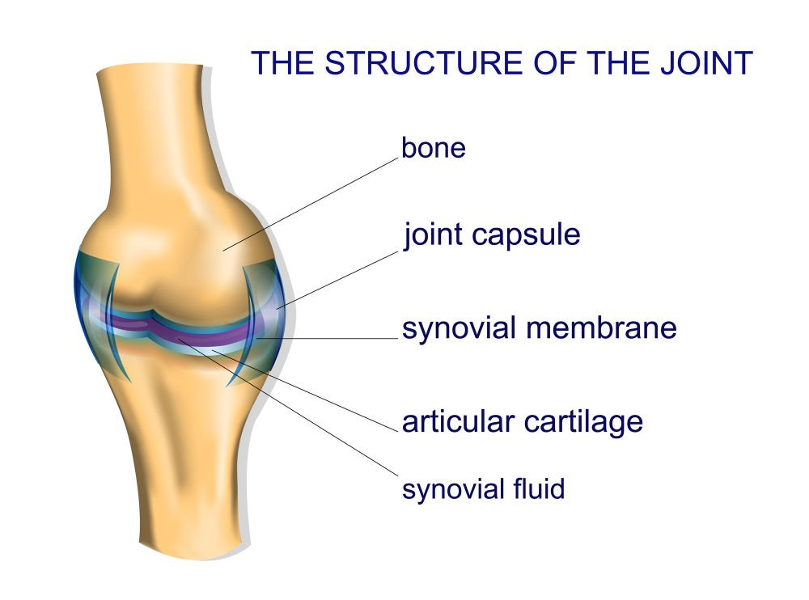
Structure of a Synovial Joint

Slide 96
Structure of a Synovial Joint

Slide 97

Structure of a Synovial Joint

Slide 99

Structure of a Synovial Joint

Slide 101
Structure of a Synovial Joint
Structure
Definition
Articular Cartilage

Slide 102
Structure of a Synovial Joint
Structure
Definition
Articular Cartilage

Slide 103
Structure of a Synovial Joint
Structure
Definition
Ligaments

Slide 104
Structure of a Synovial Joint
Structure
Definition
Ligaments

Slide 105
Structure of a Synovial Joint
Structure
Definition
Synovial Membrane

Slide 106
Structure of a Synovial Joint
Structure
Definition
Synovial Membrane

Slide 107
Structure of a Synovial Joint
Structure
Definition
Bursa

Slide 108
Structure of a Synovial Joint
Structure
Definition
Bursa

Slide 109
Structure of a Synovial Joint
Structure
Definition
Joint Capsule

Slide 110
Structure of a Synovial Joint
Structure
Definition
Joint Capsule

Slide 111
Structure of a Synovial Joint
Structure
Definition
Synovial Fluid

Slide 112
Structure of a Synovial Joint
Structure
Definition
Synovial Fluid

Slide 113
Responses to exercise
Responses to the skeletal system
Responses within the joint

Slide 114
Responses to exercise
Responses to the skeletal system
Responses within the joint

Slide 115
Adaptations to regular exercise
Adaptations to the skeletal system
Adaptations within the joint

Slide 116
Adaptations to regular exercise
Adaptations to the skeletal system
Adaptations within the joint

Slide 117
Additional Factors - Arthritis
Type:
Type:
Description:
Description:

Slide 118
Additional Factors - Arthritis
Type:
Type:
Description:
Description:

Slide 119
Additional Factors
Osteoporosis
Description:

Slide 120
Additional Factors
Osteoporosis
Description:

