Slide 1

YEAR 13 2026-7
WELCOME TO THE YEAR AHEAD ...

Slide 2
YEAR 13 2026-7
THE YEAR AHEAD
Mrs Amy Kennedy
Director of Sixth Form
akennedy@swchs.net

Slide 3
A Level Results
Grades | Results 2025 (274 students) | Actual 2026 (277 students)
A* | 11% | 14%
A*-A | 34% | 34%
A*-B | 64% | 68%
A*-C | 87% | 88%
A*-D | 97% | 97%
A*-E | 99% | 100%
National Average Grade: B/C
SWCHS Average Grade: B+
Notes:
These results are well head of the national picture. Nationally 9.4% achieved an A* and 28.2% achieved an A*-A grade. We are a comprehensive 6th Form and we have a lower bar for A Level programmes than many centres many courses are accessible to students with grades 4 and 5 at GCSE and so these results are really pleasing. 44% of students achieved at least 1 A or A* grade. These results will give us a positive progress score and we expect the ALPS to be a grade 2 and for our progress to be well within the top 10% of 6th Forms nationally

Slide 4
CTEC and BTEC Awards
Grades DOUBLE AWARDS | Results 2024 (68 students) | Actual 2025 (70 students)
D*D* | 8% | 21%
D*D | 24% | 36%
DD | 32% | 50%
DM | 52% | 64%
MM | 76% | 86%
MP | 88% | 96%
PP | 92% | 100%
Grades - SINGLE AWARD
D* | 9% | 17%
D | 44% | 48%
M | 79% | 86%
P | 97% | 100%
Notes:
This is a smaller cohort for us. Pleasing improvements from 2024. Again some stunning progression options for students from these courses. We always find ALPS a little harder to predict from this smaller cohort but I expect it to be a mid table result in terms of progress. As our retention is very high in this school, that is also something to really celebrate! Well done everyone.

Slide 5

Our Progress

Slide 6







Slide 7
University Choices
Over 190 students received their First Choice University
Some rejected their First Choice in favour of other places (Clearing)
15 students are going to UEA
13 students are going to Loughborough, York
12 students are going to Exeter
10 students are going to Durham
6 students are going to Oxford
2 students are going to Cambridge (2 students turned down their place)

Slide 8
Approximately 50% of the course at Key Stage 5 is taught…
Homework
Revision and Retrieval
Reading and literacy
Difficult thinking
Exam technique
Organisation
And well over 50% of the courses are completed!

Slide 9
YEAR 13
THE YEAR AHEAD
Mr Mark Hansard
Deputy Director of Sixth Form
mhansard@swchs.net

Slide 10
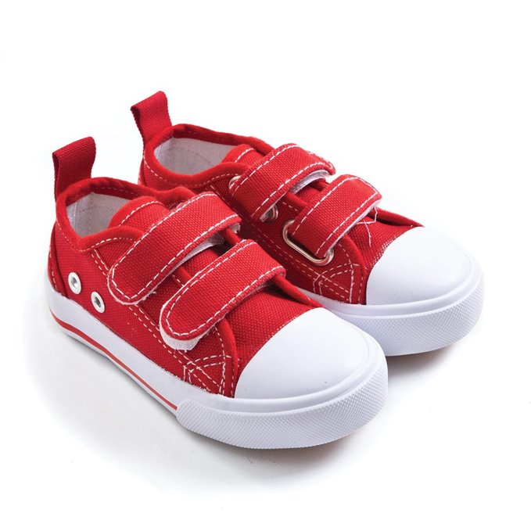

Slide 11



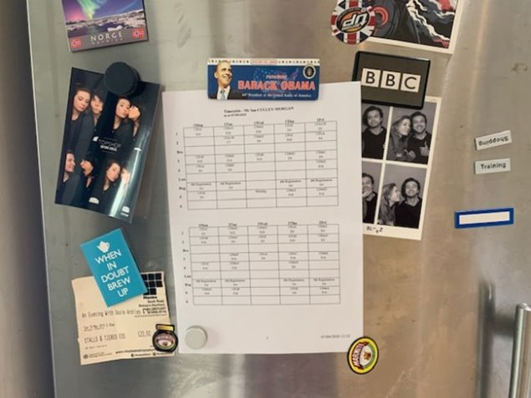

Slide 12
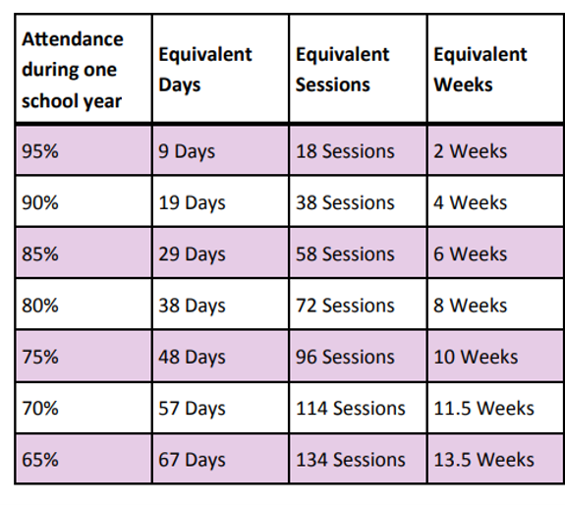
Attendance matters

Slide 13
'If we extrapolate across a three subject KS5 programme, the typical student with attendance below 85% will perform at least two grades lower than a student with attendance above 95%. In competitive university entrance and other contexts, two grades represents a life-changing difference.'
Source: The Sixth Dimension Report 2019 published by SFCA

Slide 14

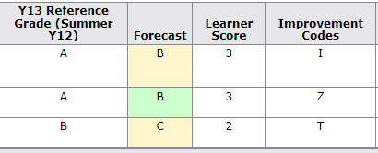
Student actually achieved C C C
Reference and Forecast Grades

Slide 15

Deadlines
The hard deadline policy we introduced last year has been successful and will remain in place.
Set centrally by the department and shared with students/parents.
When a hard deadline is missed, the student will be placed in supervised study to catch up the next day.
This will be taken by the Directors of Sixth Form.

Slide 16
Artificial Intelligence
All students need to confirm that the work is their own.
Students will receive feedback on drafts to help guide their work (where applicable).
Students should not pass off AI as their own work.
Work will be checked for plagiarism.
Plagiarism will result in an immediate failure.

Slide 17

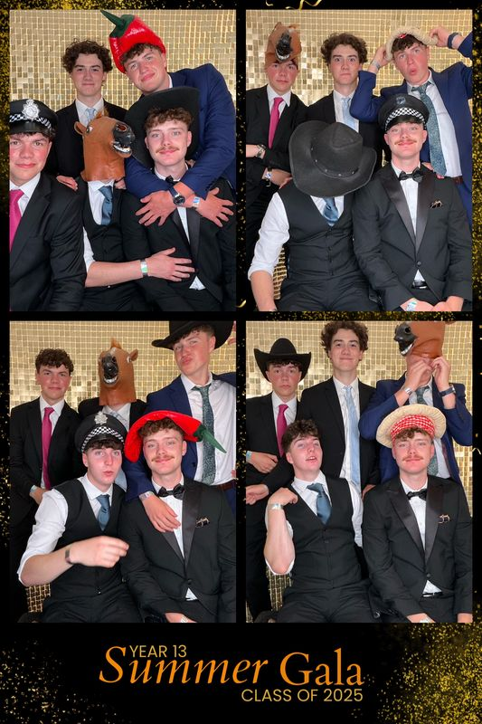


Slide 18
Important Dates for Year 13
First Progress check This will be published week beginning 23rd November
Parents’ Evening Thursday 26th November
UCAS deadlines Wednesday 13th January 2027
(Early Applicants Thursday 15th October 2026)
Mock Exam Fortnight Monday 1st March – Friday 12th March 2027
Final Progress check This will be published week beginning 22nd March 2027
Final Day Friday 7th May 2027
Summer Gala Thursday 1st July 2027
Results Day Thursday 12th August 2027

Slide 19
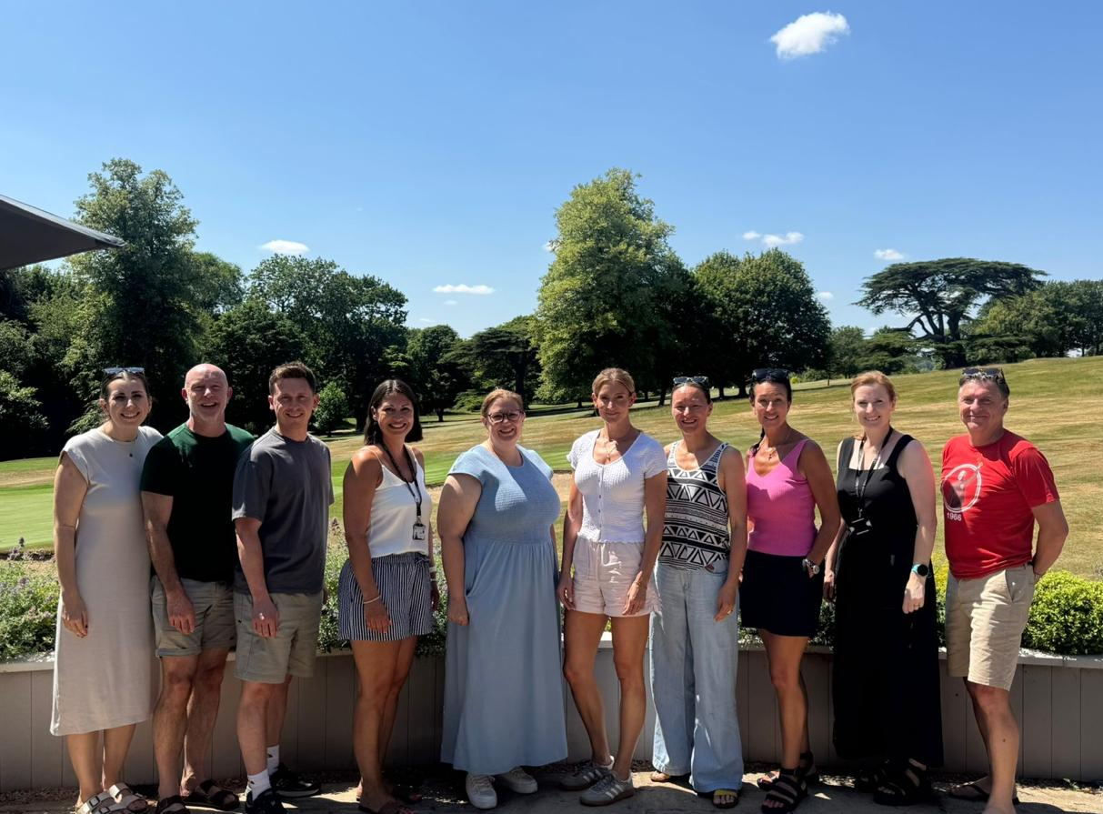
Iain Clark
Jo Chapman
Eleanor Wood
Mark Hansard
Lizzy Simons
Chloe Ward
Josh Park
Amy Kennedy
Anna Bendall
Sharon Bertie
Notes:
LY13 just gone – first students to take GCSEs since Covid
Reference grades - 9 months of study - if students want it changed - they need to prove it

Slide 20
The Sixth Form Team
Mark Hansard - Head of Year
Chloe Ward - Pastoral Curriculum
Eleanor Wood - EPQ
Iain Clarke - Early Apps
Lizzy Simons - Apprenticeships & Careers
Sharon Bertie - Apprenticeships & Careers
Josh Park - Bursary
Kirsty Jenkins - SENCO Key Stage 5
Notes:
LY13 just gone – first students to take GCSEs since Covid
Reference grades - 9 months of study - if students want it changed - they need to prove it

Slide 21
YEAR 13
THE YEAR AHEAD
Mrs Lizzy Simons and Ms Sharon Bertie
Apprenticeships, Careers & Employability
esimons@swchs.net
sbertie@swchs.net

Slide 22
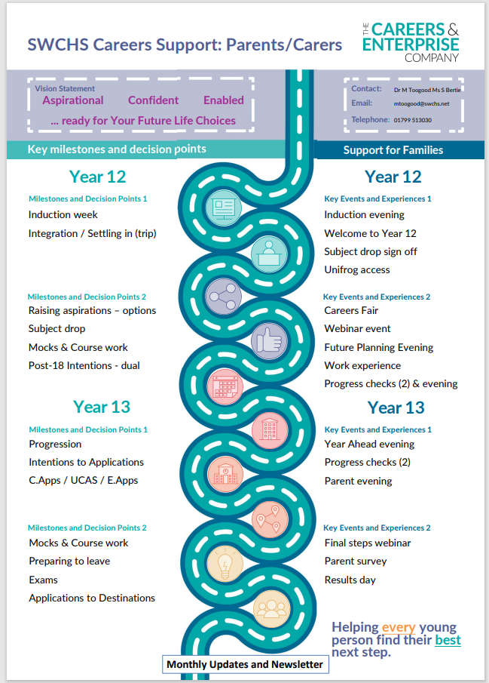
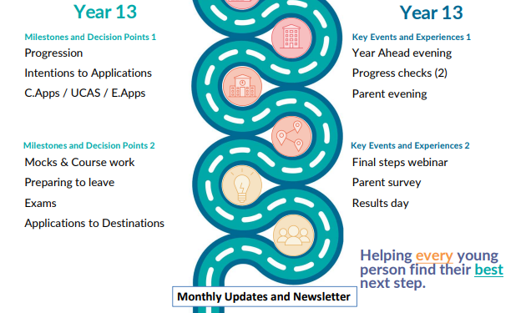
Careermag - Parents - Careermap

Slide 23
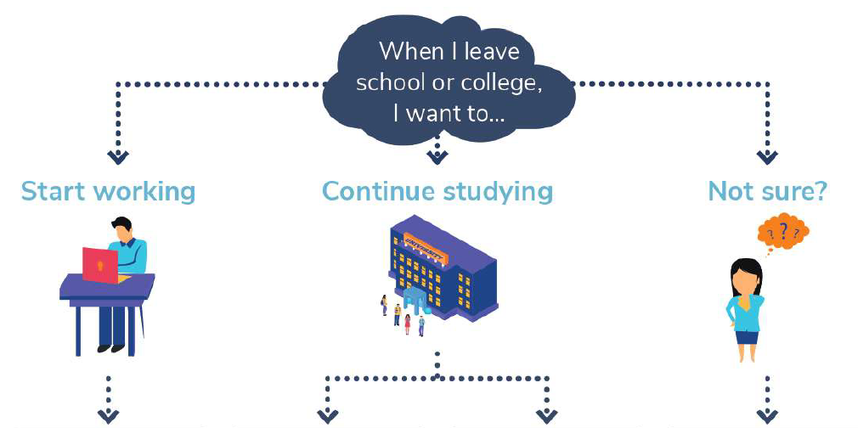
Employment
Apprenticeships
Attend university
A degree while working: Degree Apprenticeship
Gap year?
Find out more!

Slide 24
What support does SWCHS offer?
Careers Apps – an online ‘Team’ providing students with targeted daily updates and opportunities, and careers advice and support.
Weekly support sessions – Wednesday Period 5. This will focus on interview preparation, application guidance, CV support and effective job / apprenticeship research
Individual and group careers guidance discussions with our external provider.
Ongoing support from Ms Bertie & Mrs Simons our Careers & Employability Experts in the Sixth Form Collegiate, who will help students prepare for interviews, submit applications, explore employment opportunities.
Sector specific mentors – support from alumni, members of staff and external contacts, (Employment Partners), who have worked in different areas, e.g banking, finance, fashion, retail, physio, electronics, marketing, drama, construction, science, armed forces etc.
Unifrog – Universal destinations platform

Slide 25

Next Steps Key Takeaways
Proactivity
Plans A+B
Seek out the support
Newsletters are helpful!

Slide 26
YEAR 13
THE YEAR AHEAD
Mrs Kirsty Jenkins
SENCO
kjenkins@swchs.net

Slide 27



EHCP
  Annual Review
  1:1 Support
  PCP
SEND Register
  PCP
Exam Access Arrangements
gdrake@swchs.net
UCAS
  Look at universities carefully
  Open Days
    Talk to the course providers
    Talk to the support team
  Contextual Offers
Employment and Apprenticeships
  Look at employers and apprentice providers carefully
  Ask questions about support
BE
HONEST
Has anything changed?
Please keep us updated with any changes which may impact the learning taking place this year or which may influence future opportunities.

Slide 28



Slide 29
FIND THE TUTOR
13A​ | Mr Wilson​ | D9
13B​ | Mrs Craddock/Dr Wood​ | S1
13C​ | Mrs Makepeace/Mr Wheeler​ | S2
13D​ | Miss Doddrell​ | D5
13E​ | Mr Culley-Morgan​/ Mrs Macro | D11
13F​ | Mrs Church​ | D7
13G​ | Mr Syposz​ | D4
13H​ | Mrs Ogilvy/Mrs Johnston/Mrs Butler​ | S3
13I​ | Mrs Boulton​ | D6
13J​ | Mr Weersing​ | D10

Slide 30
Notes:
LY13 just gone – first students to take GCSEs since Covid
Reference grades - 9 months of study - if students want it changed - they need to prove it

