Slide 1
Met new friends
Met multiple new teachers
Logged into the school system
First proper assemblies in SH
Learned to navigate the school
Used Microsoft Teams
Received their first timetable
Fingerprint taken for Arbor
Played on their own field
Rehearsed a fire drill
Lunch in 3 new eating areas
All in just 4 days…

Slide 2

Welcome to the Year 7 Ahead Evening
Headteacher: Polly Lankester​
​
SLT Link: Katie Vanderpere-Brown​
Year Achievement Coordinator (YAC): Miss Lauren Coates
Deputy YAC (DYAC): Mr Andrew Osborne
Student Support Officer (SSO): Mrs Vicki Parkes
Notes:
Lauren

Slide 3

Home-school partnership
There is a powerful association between parental involvement and student achievement and attainment.
Parental involvement in the form of at-home interest and support is a major influence upon educational outcomes.
We all want the same thing!
We want our children to achieve their personal best.
You can support your child through encouraging
Attendance at school
Attendance at extra-curricular clubs
Support with homework
Support with organisation
Speaking positively about school at home
Notes:
Lauren

Slide 4

S
W
C
H
S
V
A
L
U
E
S
Show respect
Work hard
Care for others
Have integrity
Show resilience

Slide 5
Key Dates
Mon 21st September | Year 7 School Photographs
Fri 9th October | Non uniform day – World Mental Health Day
Wed 21st October | Year 7 Halloween Disco
Mon 2nd November | Term resumes for students – Timetable Week B
Wed 4th November | Y7 English Escape Room Challenge
Notes:
Lauren

Slide 6

Recognising achievements
We have lots of ways to reward your child for their hard work at SWCHS including:
Achievement Points: Awarded for great work in class.,
Postcards Home: Sent by teachers as a ‘well done’.
Headteacher’s Commendations: For outstanding work.
Awards Evening: A high-profile awards evening with food and entertainment.
Year Office Award: A weekly award to recognise excellence
100% Club: An award for excellent attendance
Notes:
(3 mins)
In the context of an inspection, e-safety may be described as…
The issues can be categorised into three areas of risk:
Content (what children may see or be exposed to eg. SPAM, violent or sexual images, misleading advice/adverts).
Contact (who children may have contact with through social networking, blogging, online chat etc. This may lead to bullying or grooming).
Conduct (how children, parents and colleagues behave online. Bullying or harassing behaviour, gambling, illegal downloads, uploading offensive or illegal images etc.).
Colleagues to be aware of own presence online.
In the context of an inspection, e-safety may be described as…
The issues can be categorised into three areas of risk:
Content (what children may see or be exposed to eg. SPAM, violent or sexual images, misleading advice/adverts).
Contact (who children may have contact with through social networking, blogging, online chat etc. This may lead to bullying or grooming).
Conduct (how children, parents and colleagues behave online. Bullying or harassing behaviour, gambling, illegal downloads, uploading offensive or illegal images etc.).
Colleagues to be aware of own presence online.

Slide 7


100+ Achievement Points
Certificate of achievement and invitation to afternoon tea (Half termly)
R4
Subject post cards, HTCs, Awards Evening and Amazon Vouchers
In addition to the achievement point system, we also have Subject specific postcards issued throughout the academic year. Termly Headteacher’s Commendations, Annual Awards Evening in the summer term and our Termly Amazon Voucher Prizes for blank Responsibility Cards.
R3
80 Achievement Points
Post card home/fast track lunch pass for three days
Rewards
40 ACH points 1 day lunch pass
60 ACH points 2 day lunch pass
80 ACH points 3 day lunch pass
100+ ACH points Certificate and afternoon tea
150 ACH Postcard
200 ACH points Certificate and second afternoon tea
250 ACH Postcard
R2
60 Achievement Points
Post card home/fast track lunch pass for two days
R1
40 Achievement points
Post card home/ fast track lunch pass for one day

Slide 8
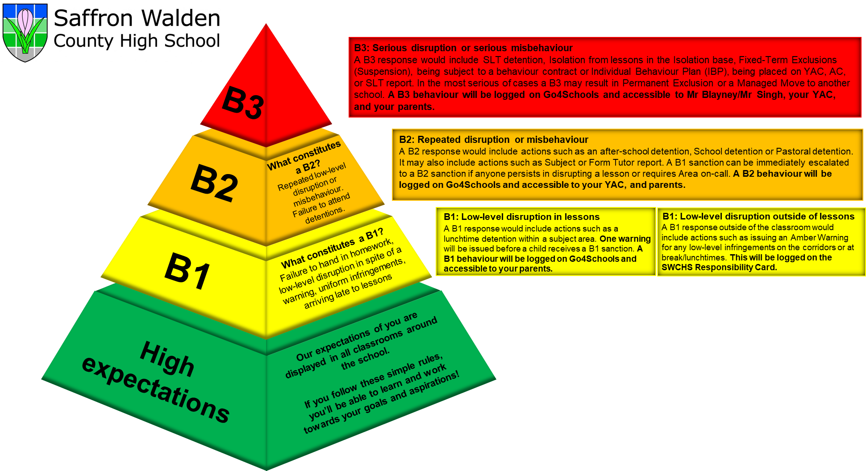
The SWCHS Behaviour Approach
Notes:
(3 mins)
In the context of an inspection, e-safety may be described as…
The issues can be categorised into three areas of risk:
Content (what children may see or be exposed to eg. SPAM, violent or sexual images, misleading advice/adverts).
Contact (who children may have contact with through social networking, blogging, online chat etc. This may lead to bullying or grooming).
Conduct (how children, parents and colleagues behave online. Bullying or harassing behaviour, gambling, illegal downloads, uploading offensive or illegal images etc.).
Colleagues to be aware of own presence online.
In the context of an inspection, e-safety may be described as…
The issues can be categorised into three areas of risk:
Content (what children may see or be exposed to eg. SPAM, violent or sexual images, misleading advice/adverts).
Contact (who children may have contact with through social networking, blogging, online chat etc. This may lead to bullying or grooming).
Conduct (how children, parents and colleagues behave online. Bullying or harassing behaviour, gambling, illegal downloads, uploading offensive or illegal images etc.).
Colleagues to be aware of own presence online.

Slide 9
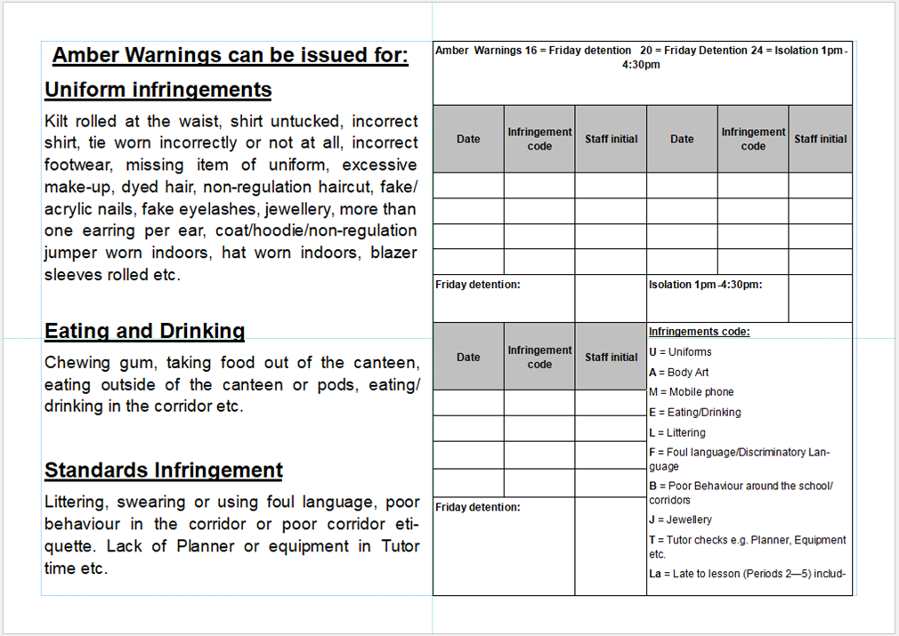
Responsibility Card

Slide 10



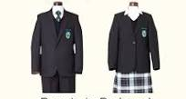
Uniform
Notes:
Andrew

Slide 11




Hair, Makeup and Jewelry
Notes:
Andrew

Slide 12
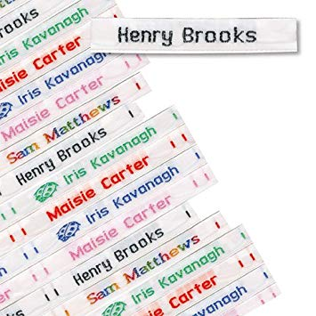
Organisation
Every Day | Set Days
Reading book Pencil case ( including a Green pen, glue and whiteboard pen) Lunch / snack / money on Arbor Homework tasks Correct exercise books Water bottle Locker key Timetable | PE Kit Musical Instrument Ingredients for Food Technology Calculator
PLEASE LABEL EVERYTHING!

Slide 13

Homework per fortnight
The Learning Centre is open everyday afterschool. Mon-Thurs until 4.30pm and Fri until 4pm. This is a supervised quiet space for students to complete their homework.
Up to 90 mins for Maths
Up to 60 min reading for English
Up to 30 mins for Science
Up to 30 mins for French
Up to 30 mins for Languages
Up to 60 mins of Guided Reading

Slide 14
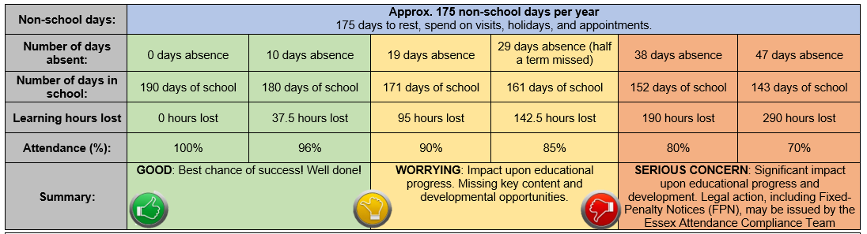
Attendance
Having a high attendance will be even more vital than ever over the next year. Your child needs to aim for at least 96% attendance! This will ensure that they make the progress they need!
Notes:
Andrew

Slide 15
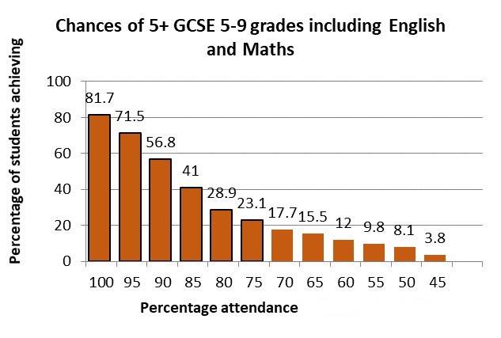
Attendance Matters
How can we work together to support attendance?
Positive, and regular, communication
Close collaboration with Year Office & Jane Buckley
Staying home/avoidance isn’t an option
A range of in-school support available

Slide 16
School absence - what information do we require?
Please provide a reason for the absence including any symptoms.
“Barry will not be attending school today as he has a virus and is showing flu-like symptoms including a high temperature”
“Vera is unwell and won’t be in today or tomorrow”
“Jeff is ill with a dodgy stomach”
“Rita was vomiting last night so will be unable to attend school. We will keep her at home for 48 hours”
Notes:
Andrew

Slide 17
Year 7 PSHE overview
Year 7 have ONE lesson a cycle
Lessons are on a carousel with a specialist teacher on each rotation
Any questions you have should be emailed to Sam Lock (Head of PSHE) at slock@swchs.net
PSHE: RSE | PSHE: HEALTHY LIVING | PSHE: SMSC | PSHE: WELLBEING | Careers
Consent | Healthy eating | British Values | What is wellbeing? | Getting Started with Unifrog
Friendship | Personal hygiene | Equality | Understanding worry | My Dream Job
Bullying | Menstruation | Online behaviour | The worry toolkit | Salary
Staying safe | Young carers | Having a voice | Gratitude and kindness | So Many Jobs

Slide 18
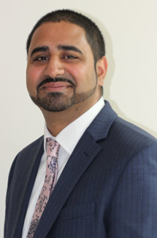
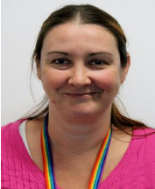
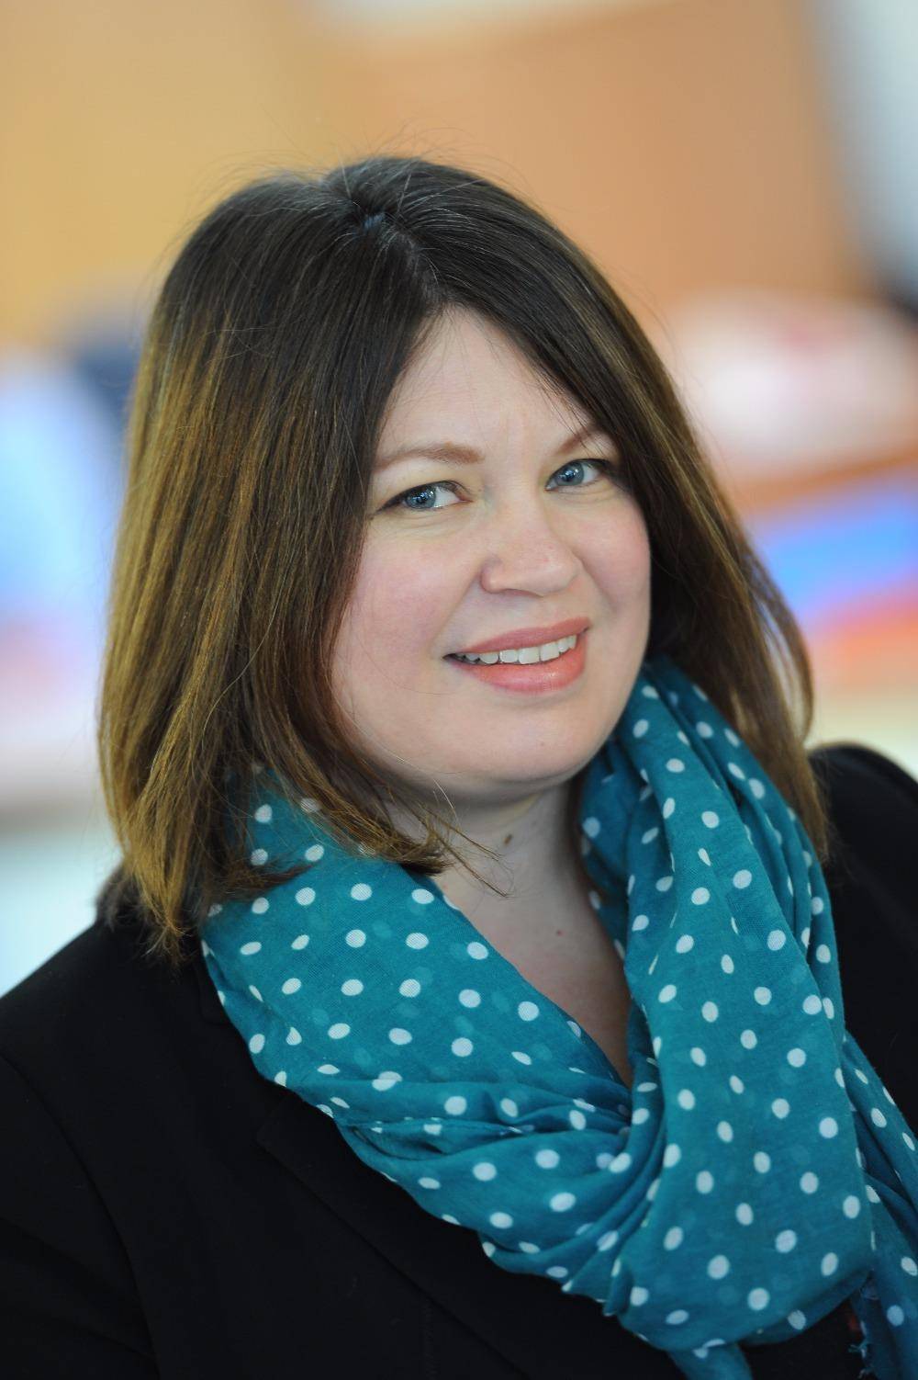
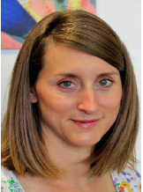
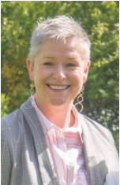
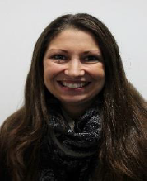
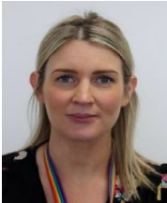
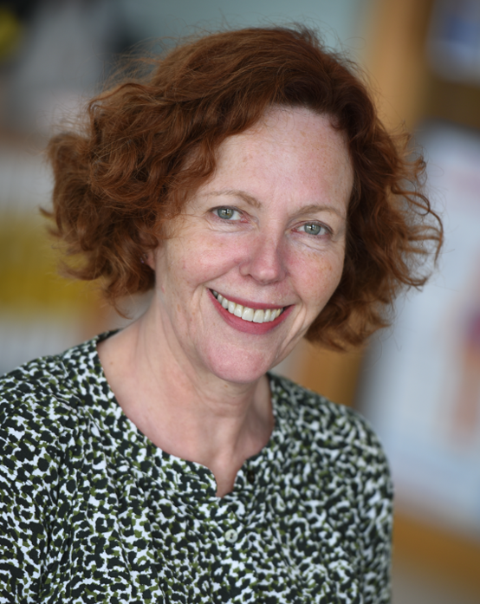

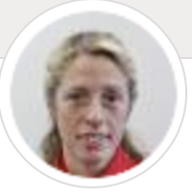
The Safeguarding Team
Paul Singh, Designated Safeguarding Lead (DSL) and PREVENT Lead
Sharon McCormick, Deputy Designated Safeguarding Lead (DDSL), Domestic Abuse lead, and CE Lead
Katie Vanderepere-Brown, Safeguarding Team and Online Safety Lead
Katie Pieri, Safeguarding Team and CIC Lead
Beth Robertson, Safeguarding Team and Lead Counsellor
Jo Chapman, Safeguarding Officer for Sixth Form
Anna Bendall, Safeguarding Sixth Form
Safeguarding Trained:
If you cannot get hold of any of the Safeguarding Team, then Polly Lankester, Amy Kennedy and Phil Heath, are also Level 3 Safeguarding trained. Andrew Osborne will also be level three trained this academic year.
Catherine Chasey Safeguarding Team and Student Behaviour, Reflection & Reintegration Lead
Beth Wheeler Safeguarding Team and learning recovery lead & Reintegration Lead
Miss Esther Blakey, Safeguarding Lead for The Agricultural Science Unit and Unit Manager
Lucinda Bell
Safeguarding Governor
All staff must read part 1 and Annex A of Keeping Children Safe in Education 2026
(2025)

Slide 19




Social Media
Notes:
Monitoring

Slide 20

Phone pouches
Thank you to everyone who has either brought a pouch or filled out the exemption form
The deadline to do this is tomorrow!
Pouches will be given out to students in Monday’s registration time
They will need to use them from Tuesday morning onwards
If you have not purchased your child a pouch or filled out the exemption form, your child will need to hand their phone into the Hush desk every morning

Slide 21
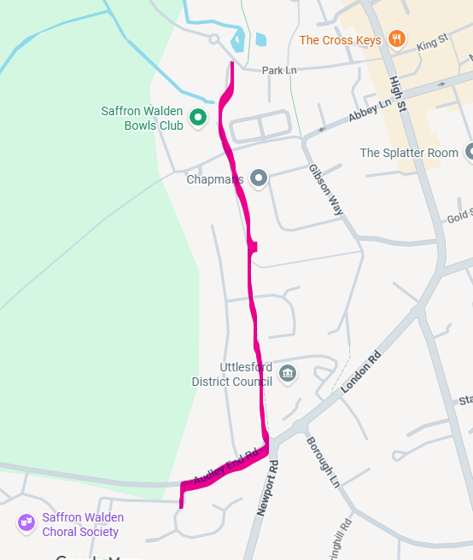
Drop off and collection
Parents are not permitted onto school site for pick up or drop off at the normal start and end of the day (unless they have been issued with a permit by the SEND department)
Please also do not drop off just outside the school site
This is a health and safety measure designed to keep our children safe
The carpark is very busy with buses and children walking across the road
It is essential that there are no additional parental cars here at these points
You are encouraged to park in Swan Medow and have your children walk there to be collected

Slide 22
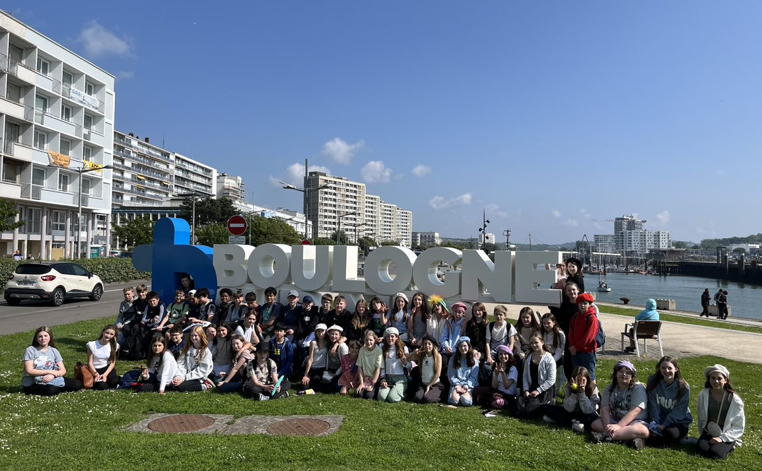
FRANCE 2027
Notes:
And I particualry wanted to draw your attention to the fact that we are organising a visit to France for students in Year 7 for next summer term.

Slide 23

France 2027
In June 2027 all students will have the opportunity to travel to France for a day
The trip is part of our commitment to ensuring that our students are offered opportunities and gain a rich cultural capital during their time at secondary school
The trip is designed to give students the opportunity to travel with their peers and teachers to experience visiting a foreign country
The cost is £160, payable in installments

Slide 24
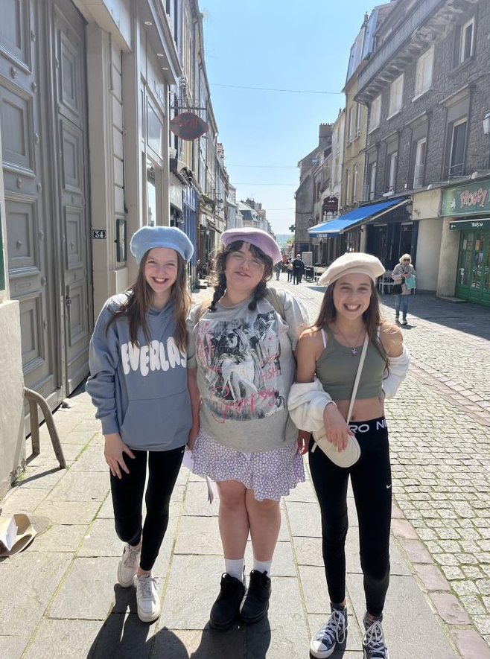
Proposed Itinerary
Depart school in the early morning and board the coach.
Arrive at Dover and board a ferry crossing to Calais – students have time to explore the boat and get some breakfast.
Travel by coach from Calais to a local bakery. At the bakery they will learn how to make croissants or baguettes in an immersive French experience. Students are also provided with a lunch.
Students then travel to the nearby Boulogne Sur Mer, where they explore the old, fortified city and have a chance to grab a treat and practice their French in shops.
A stop in a local supermarket and a chance to have some dinner
Students return home on the Euro Tunnel and arrive back at school in the evening.
Notes:
So you can see we have planned a packed and exciting day for them – a chance to practise some of their emerging French as well as spending some time in a lovely French town.

Slide 25


Slide 26
Tutor time
B1 – GG - Mrs Gemma Greenbaum & Ms Faye Kaufhold
B2 – MEX – Miss Maddie Combes
B3- RMH – Mr Robert Hancock
D3 – LXH – Mrs Lesley Hayes
D4 –BXS – Mrs Belinda Shoard
D5 – KJB – Miss Katie Bates
D6 – NAC – Mrs Neil Chamberlain
D7 – PSF – Mr Paul Facer
D9 – JRS – Mr Josh Simmons
D10 – JXD – Mr Johnny Duddy

