Slide 1

SWCHS Sixth Form: Future Planning Evening April 28th 2026

Slide 2
Session 1 and 2 Recap:
To introduce Unifrog and explain how to research options
To explain the choices available to students
To encourage you and your young person to start researching these options
To get ahead and ensure applications are as competitive as possible
To provide a map of the support available at SWCHS throughout this year and beyond

Slide 3
What options are available?
Employment
Higher Apprenticeships (1-5 years, college, university or training provider alongside employer)
Degree Apprenticeships (3-6 years, college or university alongside employer)
Undergraduate Degree

Slide 4

All options will require RESEARCH

Slide 5
Session 3: what to expect tonight
How to best use the summer months, including the end of year 12assessments
Progression plans to support students next half term
More specific steps in the application system: workshops

Slide 6
The 3 Phases of Applications
Explore and refine: Year 12, summer holidays and into Year 13
Apply: from Autumn term of Year 13
Track and choose: Spring and summer term of Year 13

Slide 7
Support available at SWCHS
Tutor groups Changes (preferences this term)
UCAS: Mr Hansard and Dr Wood as UCAS Lead
Early Applications: Mr Brown and Mr Clark
Employment and Apprenticeships: Mrs Simons and Ms Bertie

Slide 8
Recap on Careers Insights/Activities this year…
Since the start of this year, students have experienced:
Rotary Interviews and reflection
National Apprenticeship Week activities, and an Apprentice Panel & Employer Insight Event (EY & Interlinked AND SWCHS students/alumni)
National Careers Week, with talks from local and national companies aiming to demystify careers paths and industry stereotypes (Aviva and Cushman & Wakefield)
Working and studying abroad insights
Information about volunteering opportunities
A talk from the CFO from Inchcape looking at the skills needed for routes into different careers (career as a journey not a destination – illustrated via a “career wall”)
Notes:
A LOT OF INFORMATION TO DIGEST AND TO REFLECT ON – GETTING YOUR READY FOR WHAT COMES AFTER 6TH FORM –
EXPLORING YOUR OPTIONS
WHAT YOU MIGHT LIKE TO DO (OR NOT LIKE TO DO)
WHAT SKILLS YOU HAVE AND WHAT YOU MIGHT NEED TO DEVELOP
WHICH BRINGS ME ONTO THIS WEEK’S EVENT

Slide 9
Opportunities coming up…
Work Experience
Trips
Progression days
Life lectures and lessons
Careers Insight

Slide 10
Careers Insight
Wednesday 29th April in Q6 during periods 3&4
(TOMORROW!!)
An opportunity for students to:
explore how many different careers can exist within one company!
immerse in different industries in a friendly and low-stakes manner to practice communication and questioning skills
reflect on careers that start to inspire them for later in life

Slide 11































Which companies will be there?
And more to come…

Slide 12




29th June – 3rd July
180 companies on the list
3 special
Online experiences
  Springpod
  Futures For All

Slide 13
Work Experience:
Key take-aways
Needs to be logged on Unifrog in advance
Reflection of the experience should shape later decisions
Use Unifrog to start guiding decisions and the support you offer

Slide 14
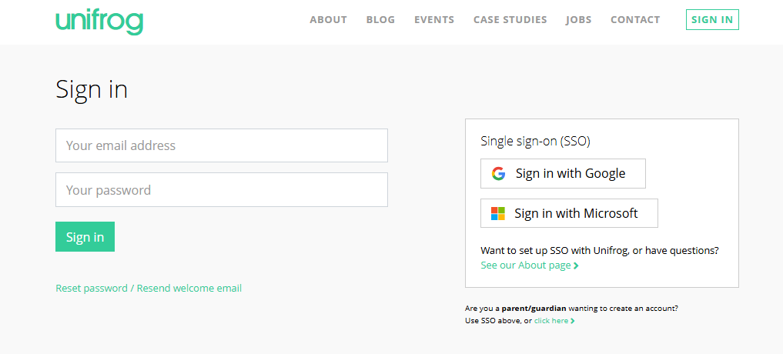
Unifrog Parent Page- logging in.
You can either go to: www.unifrog.org/parent OR www.unifrog.org and find this section and click on ‘click here’
If you are logging on for the first time, you just need the email address that is linked to your child’s school account (probably the one you receive school emails to)
It will then ask you to create your own password.
This gives you access to your child’s Unifrog page and a whole range of guides and resources for parents including:
-Post-18 options you might not have considered
- How can you help your child prepare for Clearing?

Slide 15
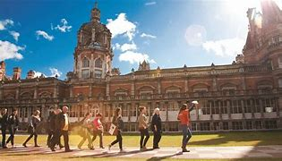



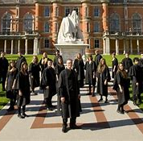
Y12 UCAS & UNIVERSITY TRIPS
***ON WISEPAY NOW***
HARD DEADLINE 15TH MAY
16TH JULY £25
16TH JULY £25
24TH JUNE £14.50

Slide 16
Exploring University Trips
The visits will consist of campus facilities and accommodation tours, talks from current students, subject taster sessions and Higher Education lectures like:
Why University?
How to Choose Your Course and University
Study Skills and Making the Most of Y13
Personal Statements
UCAS Uncovered
Student Life
Student Finance

Slide 17
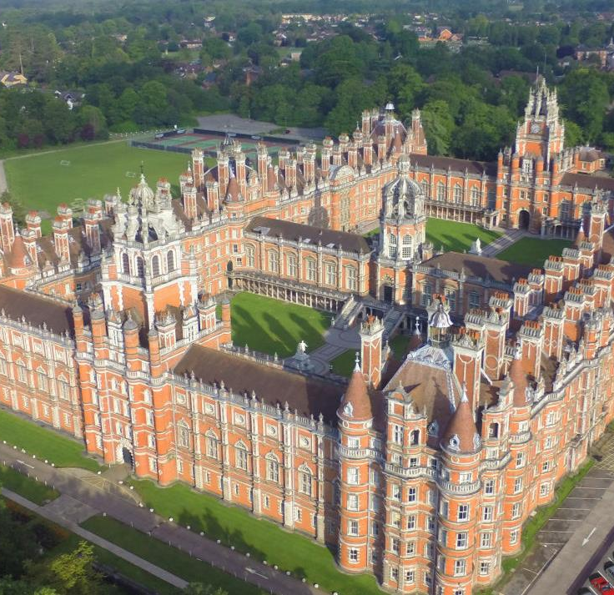
Royal Holloway University College London
Offers a huge array of courses ranging from Engineering, Bio-Medicine, Politics & International Relations or Humanities to creative courses such as Performing Arts, Music & Theatre and some non-traditional options like Ecology and Conservation with a Year in Industry, or Translation Studies with History of Art (refer to their website for more info.
It is a campus-based university, within easy access of London.

Slide 18
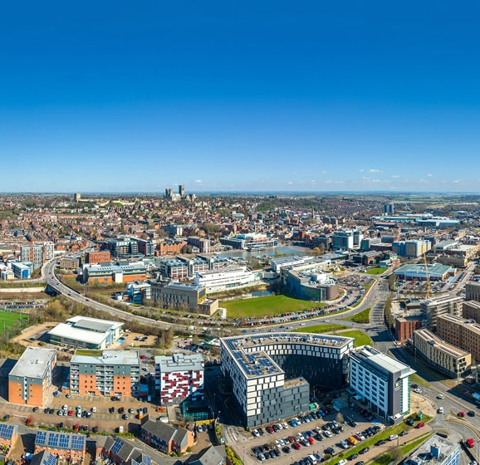
University of Lincoln
Offers a vast array of courses from the traditional - Banking and Finance, Psychology, Pharmaceuticals and Biochemistry to the creative, (and a lot in between): Animation, 3D Design, Media & (Sports) Journalism, Law & Criminology, Nursing and so on.
University of Lincoln is a city-based university, with two other campuses just outside the city itself.

Slide 19
Our Recommendations
Look at BOTH universities and employers
1
Consider what is best for YOU rather than just external league tables or reputations
2
Start to create shortlists and explore rather than being fixed – a lot can (and does) still change
3

Slide 20



How important are Year 12 end of year assessments?
In-class Revision Week: 1st June
Tests:4th June- 12th June
Completed in lessons
BTEC and CTEC lessons resume as normal

Slide 21
End of Year Reporting:
Reference Grade: the grade that will be used for applications.
Realistically optimistic and can be up to one grade higher than forecast grades.
Reference Grades can be reviewed again in the Year 13 progress check.
Forecast Grade: the grade students are on track to achieve, using the evidence of work produced from across the year (including year 12 tests).
It is an evidence-based grade.

Slide 22

What role can you play as a parent/carer?
Help with the research
Build in strong routines at home
Limit paid work (12 hours max)
Do not write the personal statement/application form
Open Days or Recruitment Days (no more than 5 please)
Be flexible, listen, accept their choices. They still need your support!

Slide 23
Are you willing to share your story or inspire the next generation?
We would love to hear from you!
Please email SBertie@swchs.net to express your interest

Slide 24
6pm-6:25pm | General Talk in Saffron Hall for all Parents
6:30-7:00pm | Applying to University (SAFFRON HALL) | Making an Early Application (BA subjects) (ROOM D4) | Apprenticeships and Employment (STUDY CAFE) | Music Applications (ROOM D6) | Drama School Auditions (including Conservatoires) (ROOM D7) | Art and Portfolio-based applications (ROOM D5) | Student Finance Wizeup SIXTH FORM STUDY CENTRE
7:00-7:30pm | Applying to University (SAFFRON HALL) | Making an Early Application (BSc subjects plus Medics & Vets) (ROOM D4) | Apprenticeships and Employment (STUDY CAFE) | NHS Professions (ROOM D6) |  | Studying and Taking a Gap Year Abroad (ROOM D5) | Student Finance Wizeup SIXTH FORM STUDY CENTRE

