Slide 1

DofE Bronze Parent Briefing
Please note this meeting will be recorded. In the unlikely event that I’ve set this meeting up correctly, your microphones and cameras should be automatically switched off. You should be able to ask questions on the chat.

Slide 2

Payment reminders

Slide 3
If you are not a member of a Team called either ‘Bronze DofE 2026 Walden’ or ‘Bronze DofE 2026 Saffron’ please write your name in the chat now

Slide 4
If you feel able to support DofE at SWCHS more please let us know dofe@swchs.net
  Volunteering time – award verifiers (checking certificates), fundraising, being an assessor for individual sections, offering support for first aid training for Silver and Gold.
  Kit donations – any camping equipment that is safe (no petrol stoves etc) we will consider

Slide 5
Behaviour on DofE
Largest school-based provider of DofE in Essex (over 300 participants across the three levels)
Require students to show independence, take responsibility and listen to instructions/ advice
The Let’s Get Out team should be treated with the same respect and authority as any member of staff

Slide 6
Staffing for Expeditions

Slide 7
Staffing for Expeditions
Let’s Get Out
  DofE Approved Activity Provider
  Significant experience and high-quality provision
  All staff are enhanced DBS checked
  Lead on all areas of the expedition section
    SWCHS staff only for oversight and pastoral link but there will be members of SWCHS staff on site on all days
  https://letsgetout.co.uk/swchs SWCHS specific information (dates to be updated)

Slide 8

Training, practice and expedition dates
MEE

Slide 9
Dates – must attend all dates for your cohort
Cohort “Saffron”
Cohort “Walden”
In School training morning: 31st January 2026
Practice day: 16th May 2026 (SWCHS)
Assessed expedition: 5th/6th June 2026 (Little Walden → Abingdon)
In School training morning: 28th February 2026
Practice day: 13th June 2026 (SWCHS)
Assessed expedition: 3rd/4th July 2026 (Little Walden → Abingdon)

Slide 10
Expedition Training
  Online expedition training certificate & Training session earlier in the year
  Training is through LetsGetOut website
    This is launched at their Saturday training morning and will be an assignment on Teams
    SWCHS staff cannot access the admin side of this. We cannot reset passwords or help you with logging in etc. Please message the LGO team for this.
    You CANNOT rush this training. It stops you continuing if you try to do it in one go. Try doing 20 minutes each weekend or similar.
    Printed certificate for the practice day. (Can print at SWCHS library)

Slide 11
Clothing
Day | What to bring
Saturday morning (S: 31st January) (W: 28th February) | Training taking place inside in the Gallery in the PE block, no need for walking boots etc. You can bring snacks!
Practice (S: 16th May) (W: 13th June) | Outdoors all day on the SWCHS field. Please bring warm, clothing, waterproof jacket and trousers and walking shoes (and, if we’re lucky, sun cream and a hat). Please bring the rucksack you’re planning on using so you get used to walking with it. Please bring a packed lunch (we will not be cooking on this day so nothing that needs heating!)
Expedition (S: 5th – 6th June) (3rd – 4th July) | We will go through this fully in the training

Slide 12
Rucksack hire
You will be able to hire a rucksack cheaply from Let’s Get Out so you do not need to buy one. We will share this link once LGO set it up.
Please book for the expedition date and it will also be available for training.
We have a code for PPG students which will be sent out to those eligible. This allows free rucksack hire.

Slide 13
Kit for Expedition
Provided for you:
Tents
Stoves
Gas
Maps
Compasses
There will be a summer term letter about expedition kit (e.g. waterproofs, walking boots, food, sleeping bags, sleeping mats etc that you do need to borrow from a friend/ buy)

Slide 14
Tents and Teams
MEE

Slide 15
Expedition student groups
All students camp on the same site
Most tents will have 3 people though some may have 2
We match up ‘tent groups’ to create ‘walking groups’. Usually these are two tent groups of 3 to create a walking group of 6.
This year we are trialling ‘clever groups’ to help us
Please complete this by the 5th January so we can assign your groups ahead of the training day

Slide 16
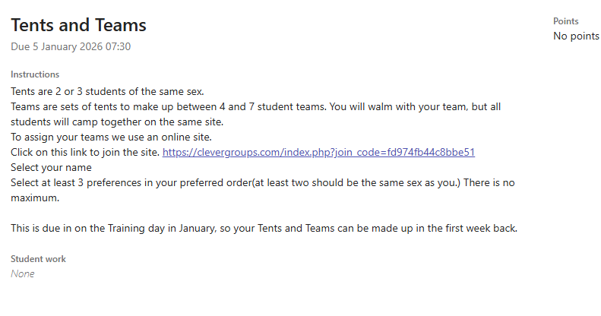

Slide 17
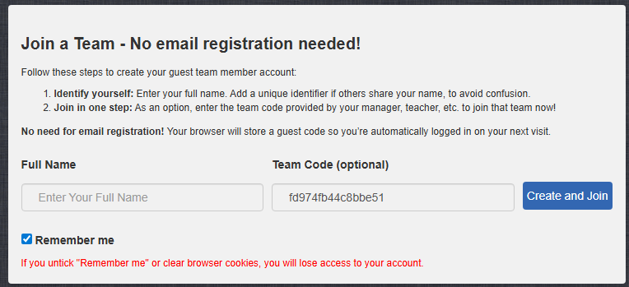

Slide 18
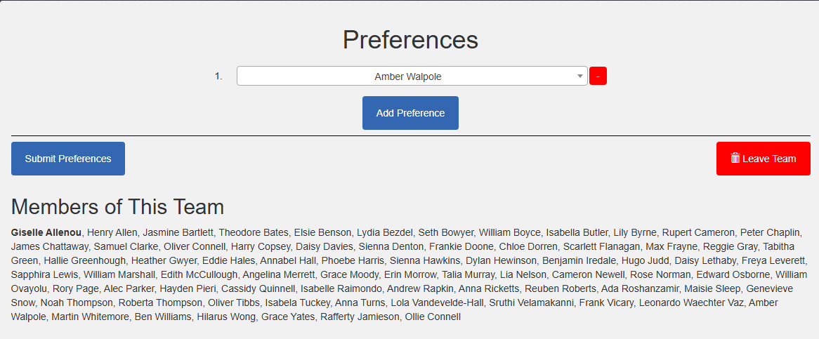

Slide 19
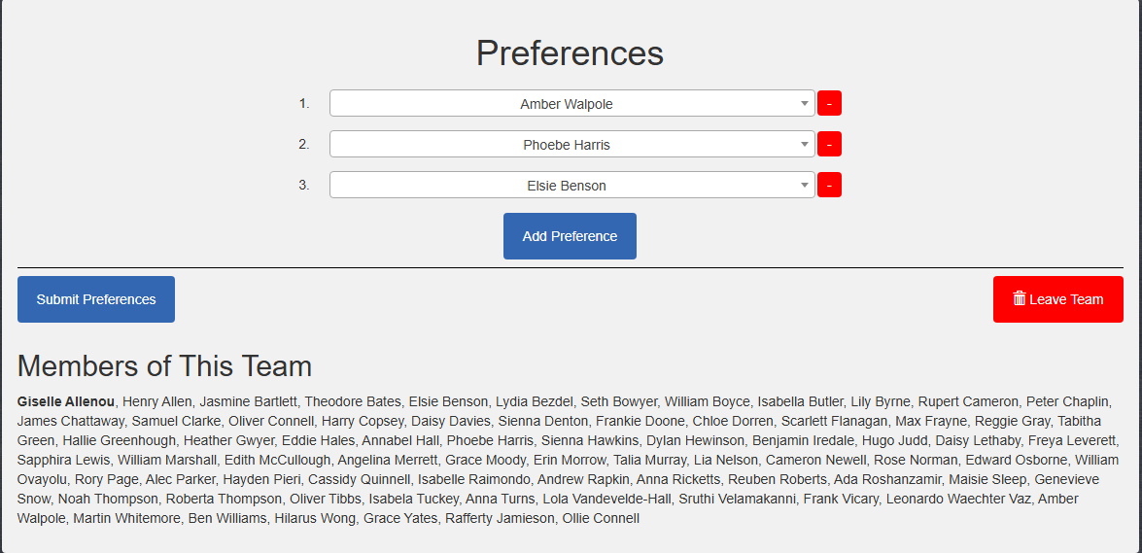

Slide 20

Bronze Award Requirements
EAC

Slide 21
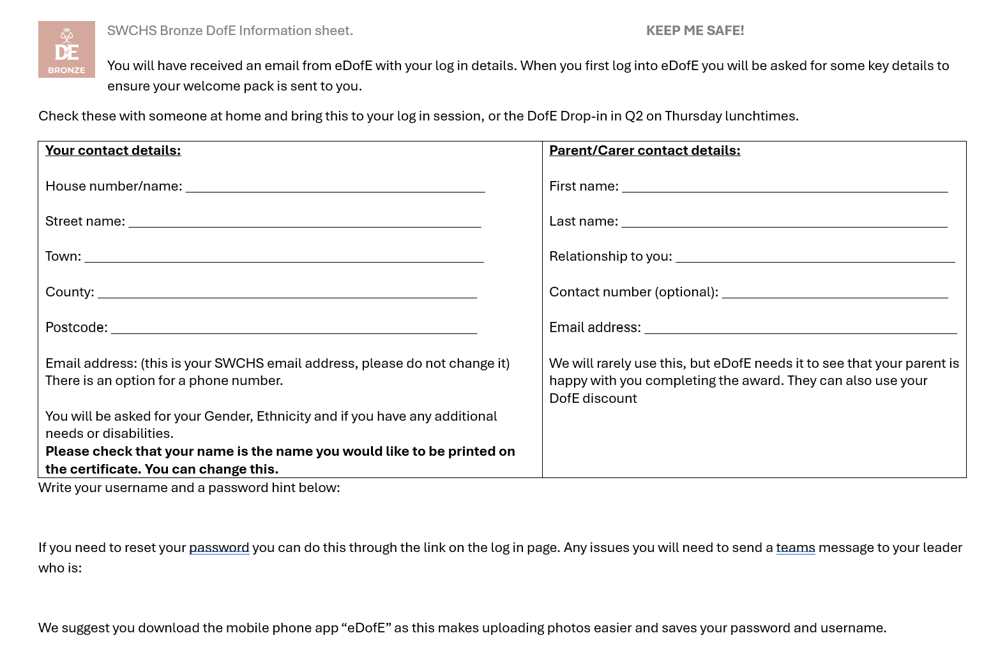
Logging in to eDofE
Log in sheet given in form
Electronic copy on teams assignment
Log in at home, on the app, or at the welcome sessions (January)
Once you are logged in and enter the contact details a welcome pack is posted to you.
Students can change their name if they want a different name on the certificate.

Slide 22
Individual sections
As well as the expedition DofE awards have 3 individual sections that need to be completed to get the award:
  Volunteering
  Physical activity
  Skills development
Each section should be completed for at least 1 hour a week.
2 sections are 3 months, 1 is 6 months (participants choice)
Each activity should be something the participant decides to do and CANNOT be part of their regular school activities.
Welcome sessions will offer students ideas about what to do if they are unsure.
Notes:
Eg. PE lessons cannot count as a physical activity
Stress the hour a week. Music lessons can only count if you include a record of practice.

Slide 23
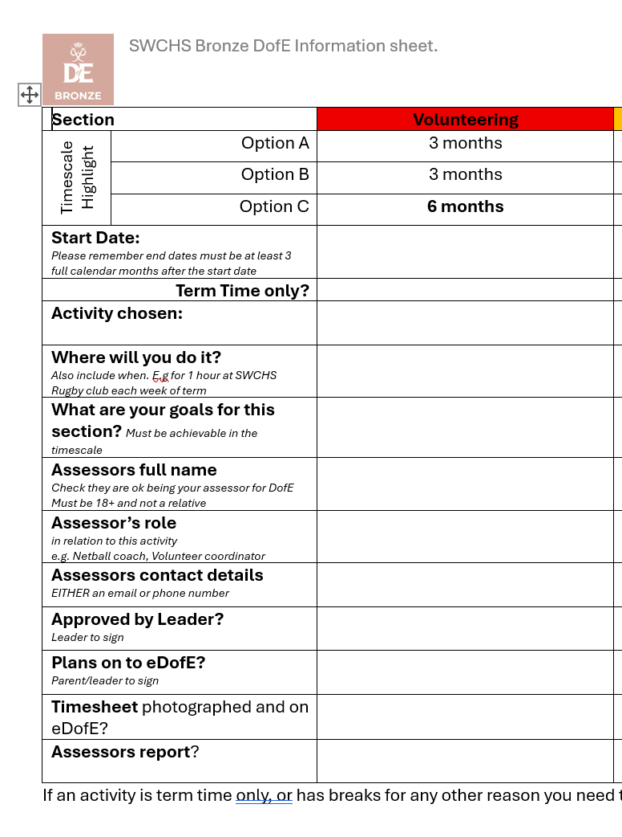
Individual sections: Plans
The reverse of the log in sheet has a planning sheet.
Please complete the sheet and get approval before putting onto eDofE. Changing on eDofE is hard.
Common issues:
Dates: At least 13 full weeks/3 full calendar months apart. Any breaks must be made up
Goals: Achievable in the 3/6 months
Assessors: Cannot be parents/friends etc. And their “role” must be related to what they are assessing you for.

Slide 24
Things that catch people out…
Skills:
  Sports appreciation ≠ watching a sports team
    It means an understanding of the history of a certain sport and the role it has played
  Music appreciation ≠ learning an instrument
    Refers to learning about music, eg a project on history of music. Use “Music” for learning an instrument.
    If learning an instrument is your skill, pick ‘playing a music instrument’
  Games and recreation ≠ sports (including golf)
    Refers to board games, strategy games, e-sports or card games
    Skills used within sports cannot count. Eg. Getting better at lay-ups in basketball is a physical activity

Slide 25
Things that catch people out…
Physical activity:
  Individual keep-fit is fine, but you will need a more detailed record, and the assessor will need to be able to judge your improvement. Cannot just say you went to the gym 13 times.
  E.g. Couch to 5k would be okay as long as you have an assessor sign it off
  Seasonal sports
    If you pick cricket, check that you can complete it for the full amount of time.
    You can switch part way though, but this is complex

Slide 26
Things that catch people out…
Volunteering:
  Cannot replace a role that would be paid. E.g being a receptionist
  Cannot be with a profit-making organisation. This often includes things such as vets.
  Cannot be in exchange for something. Eg volunteering to help much out horses in exchange for riding lessons will not be allowed.
  If you are helping an individual, you will need to explain why they are unable to manage this themselves. E.g. Taking the bins out for your family is not usually going to count.
  Year 9 is a tricky year for volunteering as many will not accept those under 14. We have some in school options available.

Slide 27
Completing a section
What a Leader must look for from the student:
  Plan is clear and achievable.
  Each section meets the aims of the section.
  Not part of the school curriculum.
  Not breaking the law
  Student has at least completed the minimum of 1 hour a week for 13/26 weeks.
    Include timesheets: electronic ones are on a Teams assignment. Printed versions can be collected from the year 9 office.
What a Leader must look for from the assessor's report:
  Clearly written by the assessor, not the participant
  Dates are correct and match the plans
  Mentions how they have improved over the time period.
  Mentions how often and for how long they did the activity.
  Is signed and dated
This can be on the paper form or submitted online
Notes:
Eg the volunteering section needs to be helping and not slavery, the physical section needs to be an actual physical activity, the skills section has to be a skill.

Slide 28

Any questions?
  DofE@swchs.net

