Slide 1

Welcome to the Year 11 Ahead Evening
Year Achievement Coordinator (YAC): Miss Lauren Coates
Deputy YAC (DYAC): Mr Andrew Osborne
Student Support Officer (SSO): Mrs Vicki Parkes
Notes:
Lauren

Slide 2
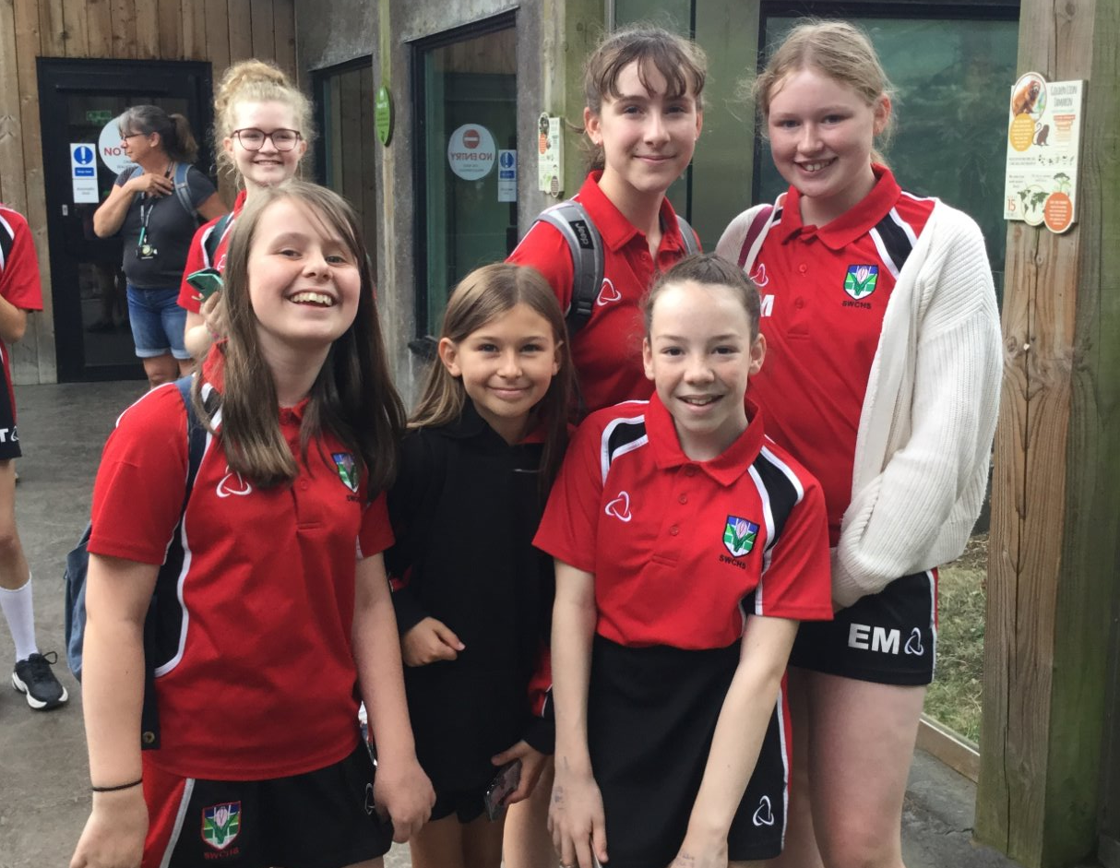
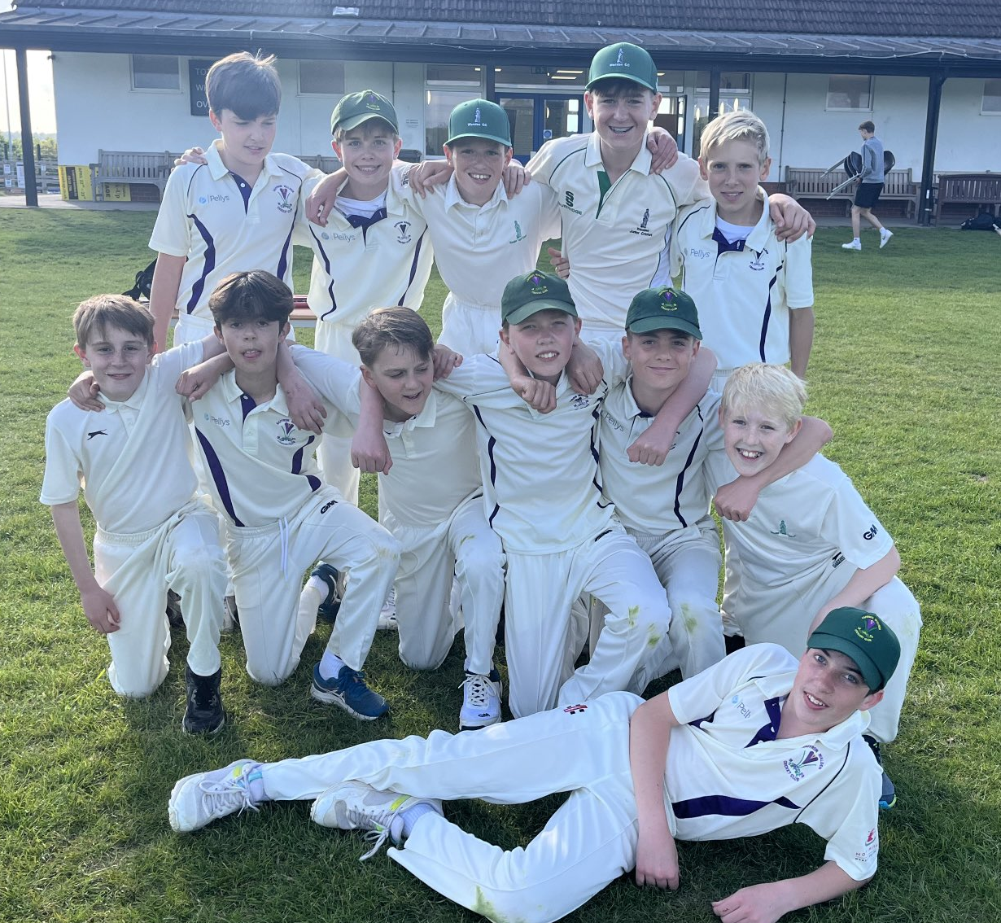
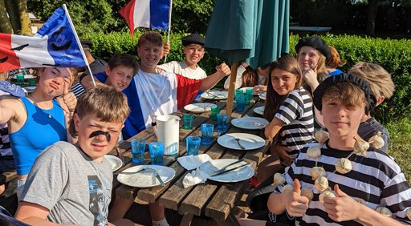
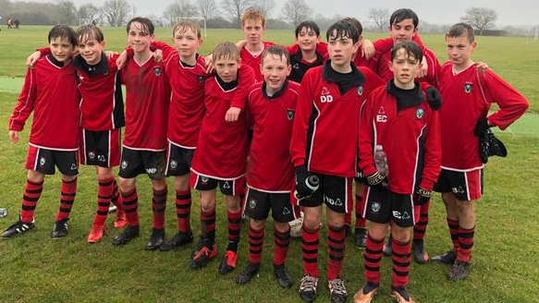
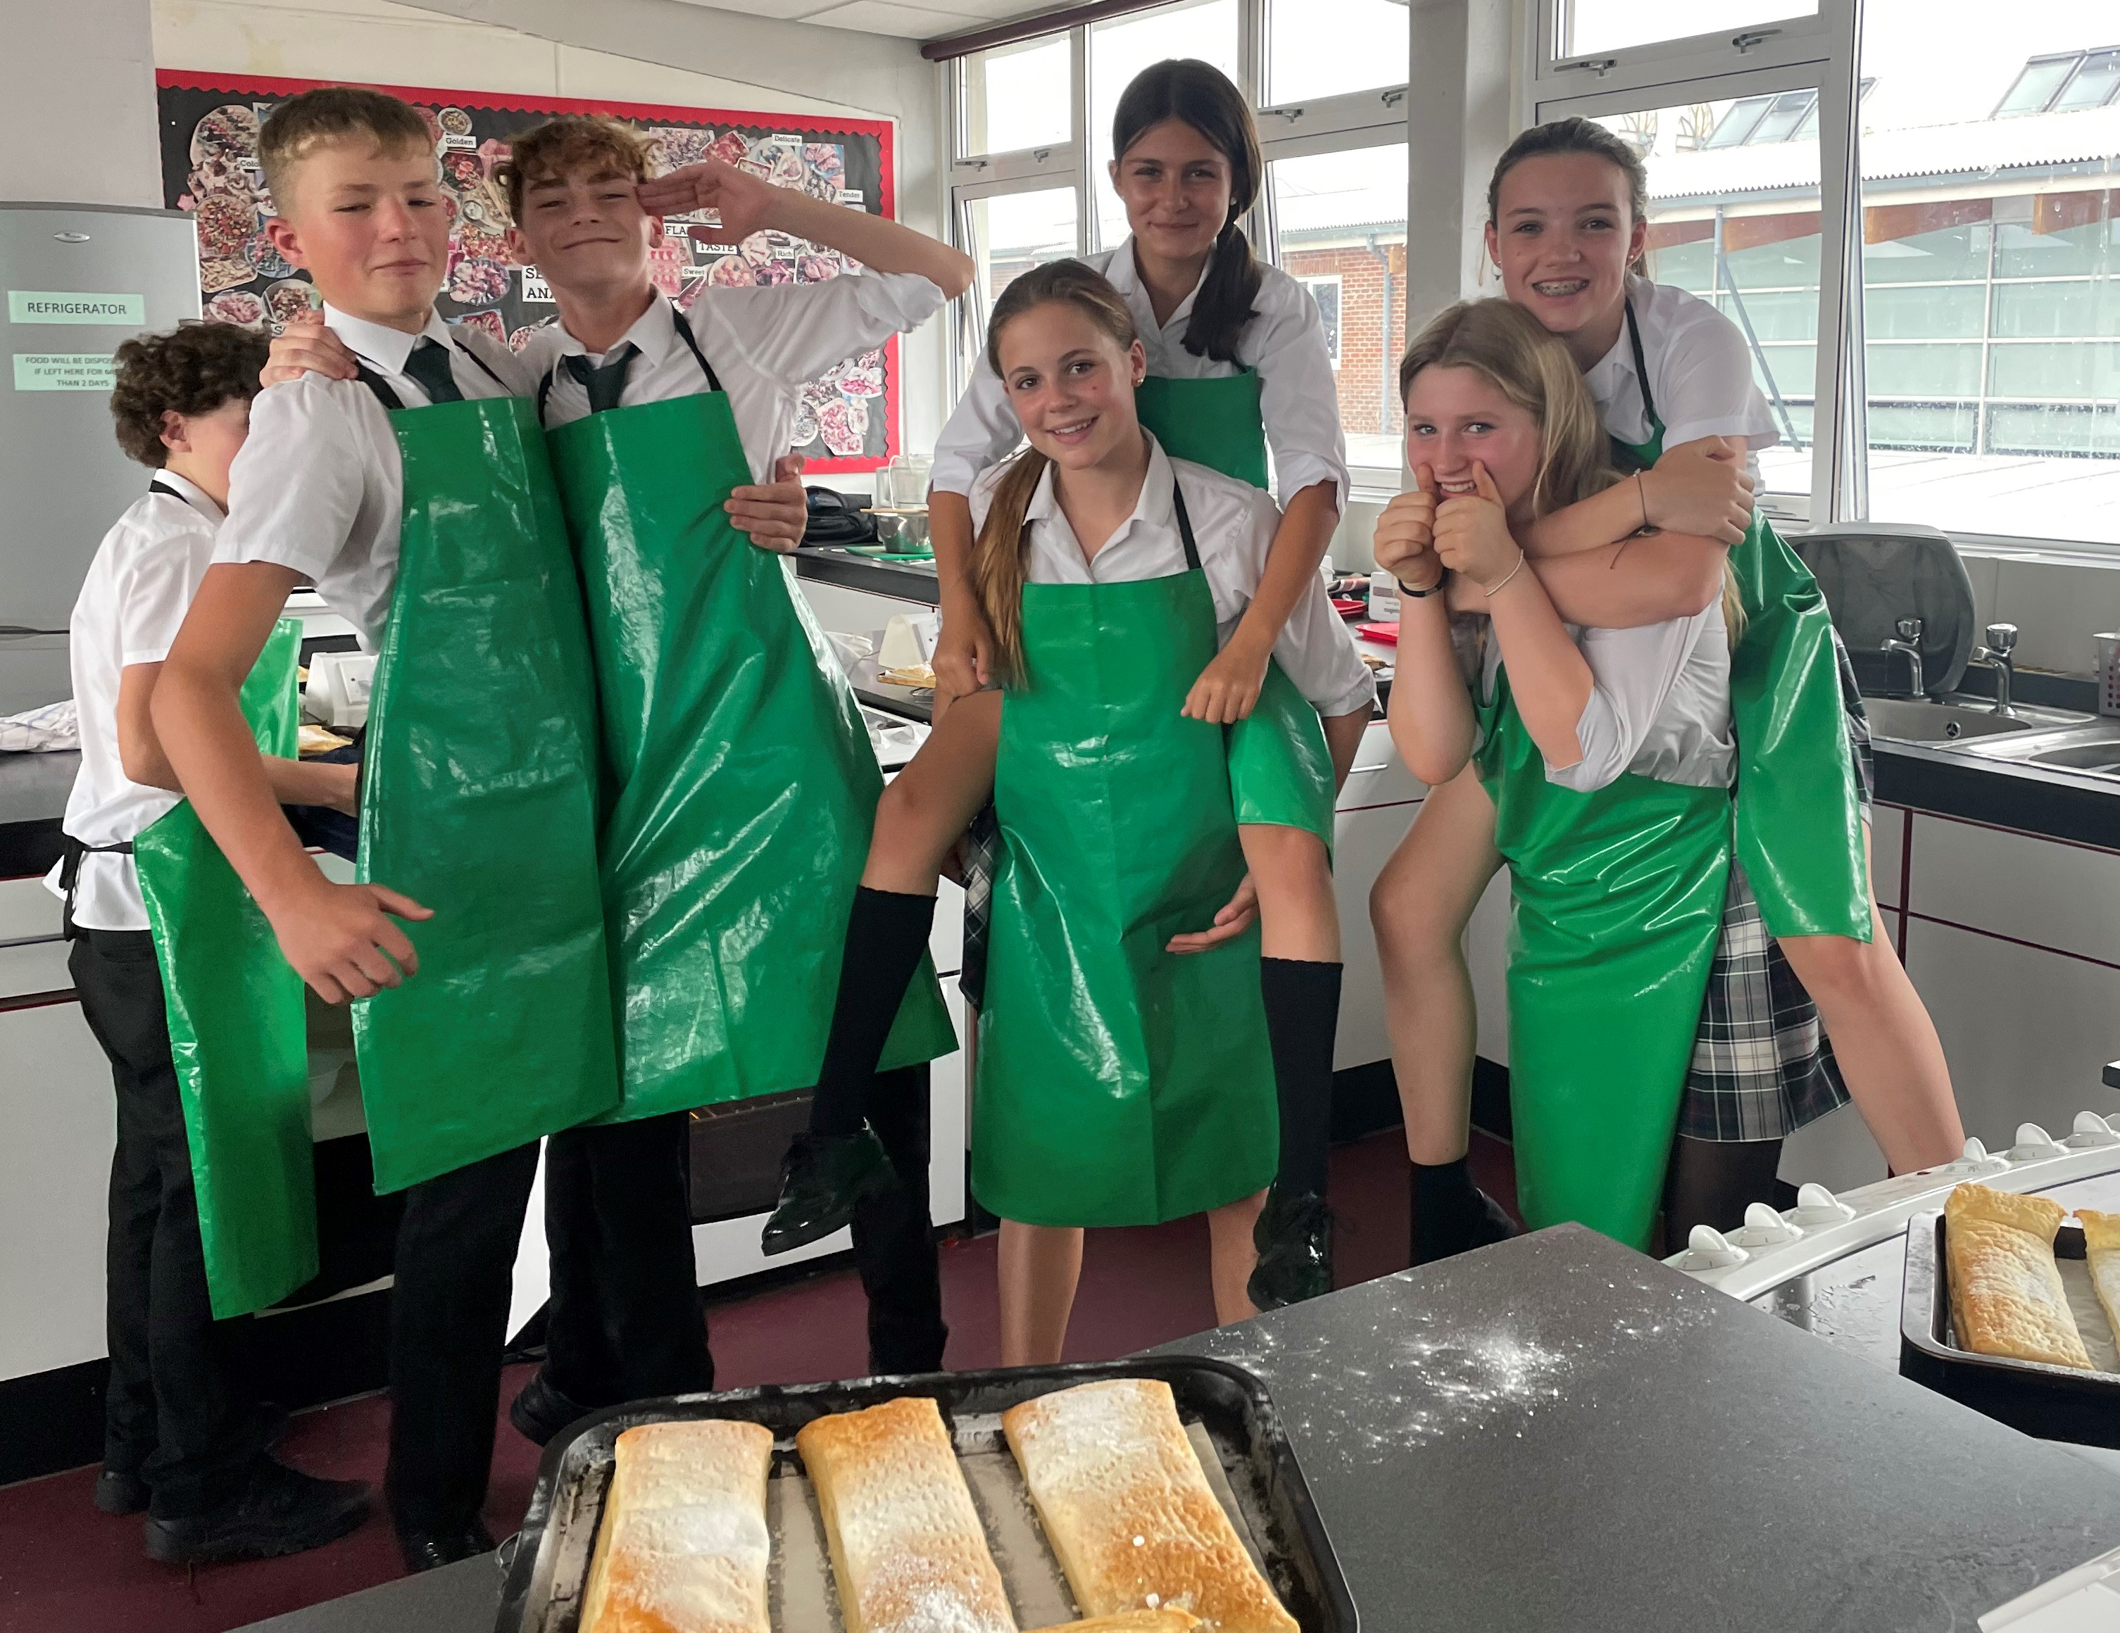
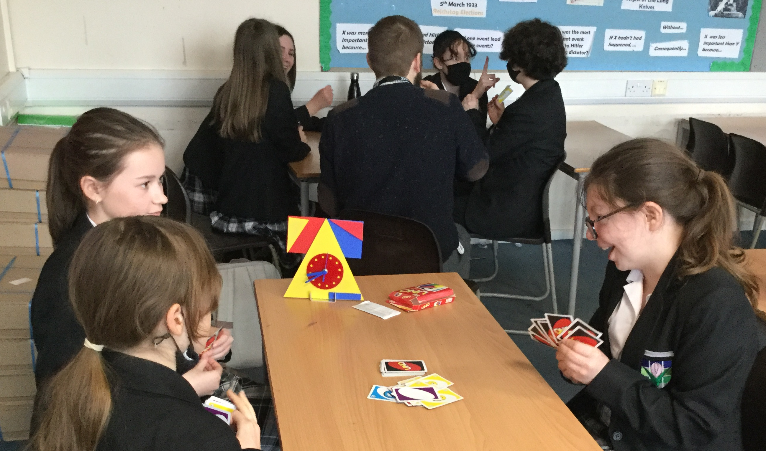
Year 11 is finally here!
Notes:
Lauren

Slide 3

Home-school partnership
There is a powerful association between parental involvement and student achievement and attainment.
Parental involvement in the form of at-home interest and support is a major influence upon educational outcomes.
We all want the same thing!
We want our children to achieve their personal best.
You can support your child through encouraging
Attendance
Revision
Attendance at intervention sessions
Speaking positively about school at home
Notes:
Lauren

Slide 4

S
W
C
H
S
V
A
L
U
E
S
Show respect
Work hard
Care for others
Have integrity
Show resilience

Slide 5
Key Dates
Wed 22nd October | Sixth Form Open Evening
Thurs 23rd October | SWCHS Sixth Form applications open
Monday 20th October | Year 11 Autumn Term Progress check published
Mon 10th – Mon 17th November | Year 11 mock exams
Mon 17th November | School Closed – Curriculum Day (invited students only in school)
Wed 7th – 16th January | Year 11 mock exams
Mon 9th February | Year 11 Spring Term Progress check published
Fri 23rd January | School Closed – Curriculum Day (invited students only in school)
Thurs 12th February | Year 11 Parents Evening
Notes:
Lauren

Slide 6
Mon 13th April | Year 11 public exams commence for selected subjects
Thurs 7th May | Y11 in-school revision timetable begins
Thurs 21st May | Y11 in school until approximately 11am. Study leave begins after the morning exam
Thurs 18th June | Public exams scheduled to finish but students must be available for the exam contingency day on Wednesday 24th June Y11 Final Assembly at 11.15am
Sat 27th June | Y11 Prom
Mon 29th June – Thurs 2nd July | SWCHS Sixth Form Induction
Notes:
Lauren
Study leave
All students will be in school until May half term. When exams begin just before half term, a special timetable will be put in place, to ensure that students have time to prepare for exams they have that day or the following day. After May half term, students will only need to come into school on days when they have exams.

Slide 7
Exams and Interventions
For each set of mock exams, students will be given information on what each mock will include and will be set specific revision tasks.
This will include 10 hours of tasks over the October half term (in preparation for the November mocks), 20 hours of tasks over the Christmas holiday (in preparation for the January mocks), and 30 hours of tasks over the Easter holiday (in preparation for the summer exams).
Students will not be set any homework over the February half-term holiday as they will need a rest after the January mocks.
All students will be given the resources and advice needed to do well in the exams. Some departments will also run targeted intervention sessions at lunchtime, afterschool, and on curriculum days. Given these are outside normal teaching hours, they will be by invitation only.
Notes:
Lauren

Slide 8
Exam Access Arrangements
•Access arrangements allow students with specific needs, such as special educational needs or disabilities, to access an exam. They allow students to show what they know and can do without changing the demands of the exam.
•They are to remove an insurmountable barrier and not to maximise potential.
•Not all students with additional needs will require access arrangements. Additional needs or a diagnosis alone do not entitle a student to access arrangements.
•If an external assessor diagnoses a learning difficulty (for example, dyslexia or dyscalculia), the assessment can only be used as evidence for access arrangements if the assessor has liaised with the school or college and received the necessary access arrangements paperwork in advance of the assessment taking place.
Notes:
Lauren

Slide 9
Exam Access Arrangements
•Specialists (for example, a medical consultant or a psychiatrist) are responsible for providing a formal diagnosis. They are not responsible for decisions about access arrangements.
•The school or college must decide which access arrangements a student has for their exams. The SENCo and Exams Access Co-ordinator will work with teachers and the student to identify possible arrangements.
•Teachers must give evidence to show that an access arrangement is needed. The school or college will record how effective the arrangement is in the classroom, in internal tests or in mock exams.
•The school or college will apply for some arrangements once the necessary evidence is in place.
•Schools and colleges must follow the rules set by JCQ. They are inspected every year and if they are found to be breaking the rules, this will be malpractice.
Notes:
Lauren

Slide 10

Homework
Year 11 students should be spending in the region of 12-16 hours per fortnight working on homework tasks.
At certain times (e.g. when preparing for an assessment) a longer piece may be set.
Students will need to spend more time working at home before exams, controlled assessments, etc.
If problems arise with several pieces due at the same time, students should speak to their subject teacher before the deadline.
The Learning Centre is open every day before school, at breaks and lunch and afterschool for students to complete homework/revision in a quiet supported environment
Notes:
Lauren

Slide 11
Part time jobs
Whilst we are fully supportive of student having part time jobs in Year 11, this shouldn’t affect their ability to complete homework or revision effectively. We would encourage students cutting back hours during the exam period.
Please be aware that according to Essex County Council, young people aged 15 to 16 years old can work a maximum of:
12 hours a week during school term
35 hours a week during school holidays
They can work between 7am and 7pm and can't work longer than 4 hours.
They must have a 1-hour break after working 4 hours.
Notes:
Lauren

Slide 12
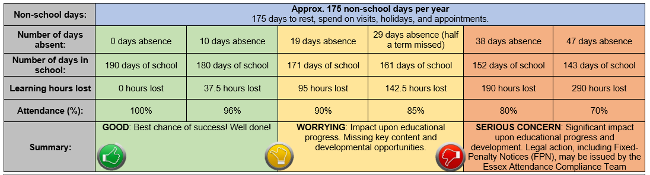
Attendance
Having a high attendance will be even more vital than ever over the next year. Your child needs to aim for at least 96% attendance! This will ensure that they make the progress they need!
Notes:
Andrew

Slide 13
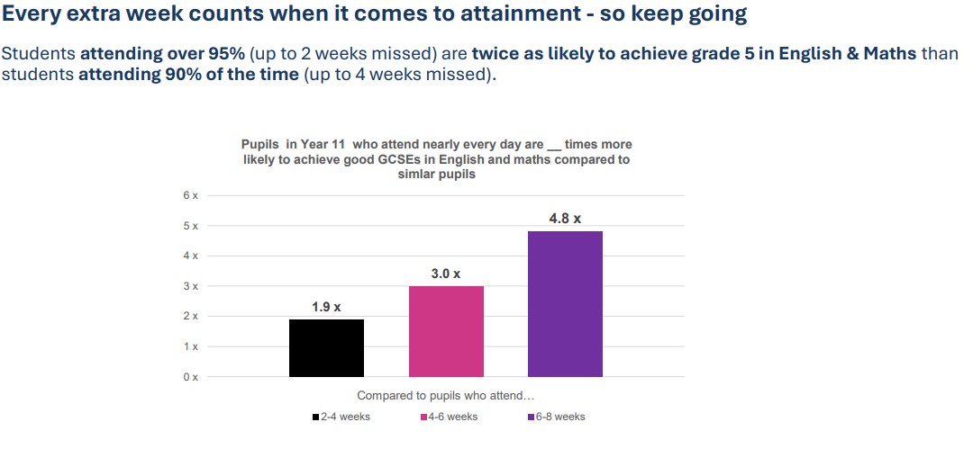
Notes:
Andrew

Slide 14
We appreciate that absence is at times unavoidable due to illness, but request that parents ensure that it is kept to the absolute minimum and that they always contact the school on the first day of absence by phone or email absence@swchs.net with an indication of length of absence if possible.
Parents should contact the school for every subsequent day of absence due to illness.
School absence
Notes:
Andrew

Slide 15


School absence - what information do we require?
Please provide a reason for the absence including any symptoms.
“Barry will not be attending school today as he has a virus and is showing flu-like symptoms including a high temperature”
“Vera is unwell and won’t be in today or tomorrow”
“Jeff is ill with a dodgy stomach”
“Rita was vomiting last night so will be unable to attend school. We will keep her at home for 48 hours”
Notes:
Andrew

Slide 16
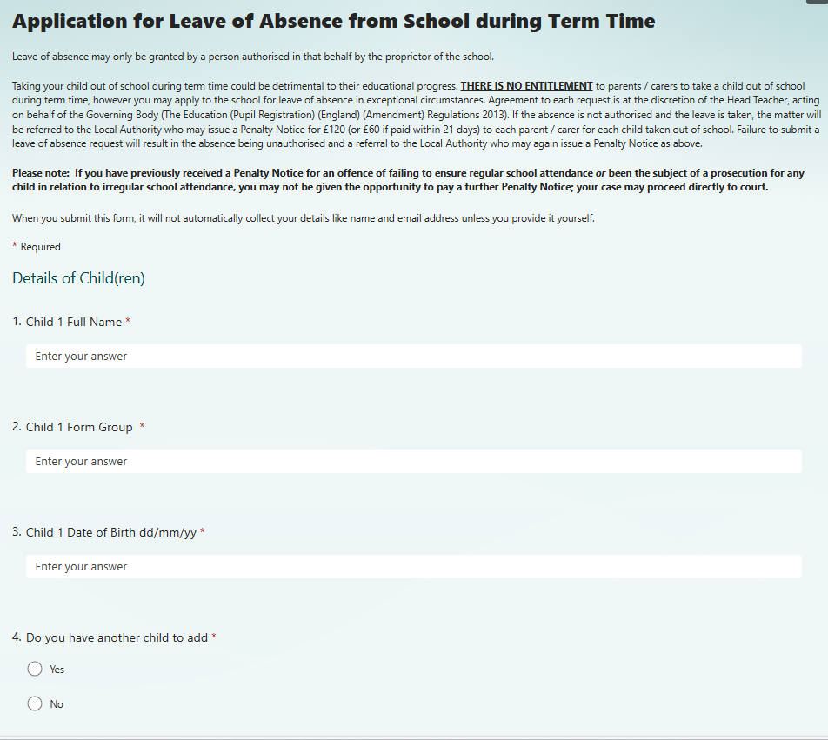
Application for Leave of Absence from School during Term Time
Please complete the online form through the school website.
Notes:
Andrew

Slide 17
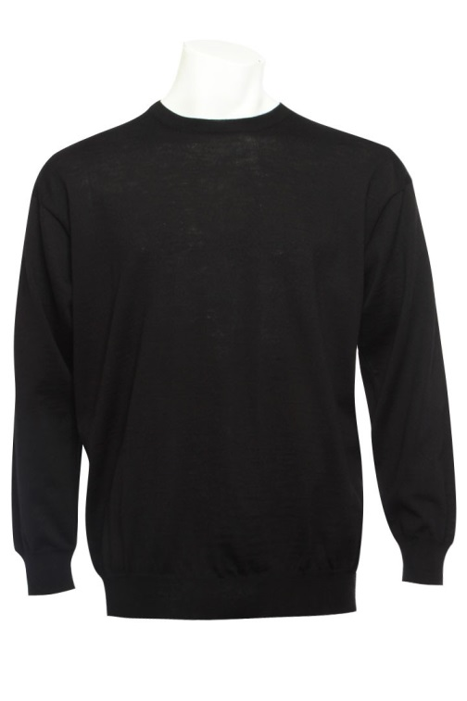

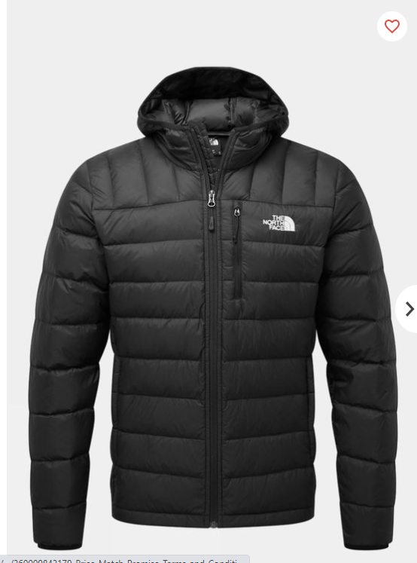
Uniform
Notes:
Andrew

Slide 18

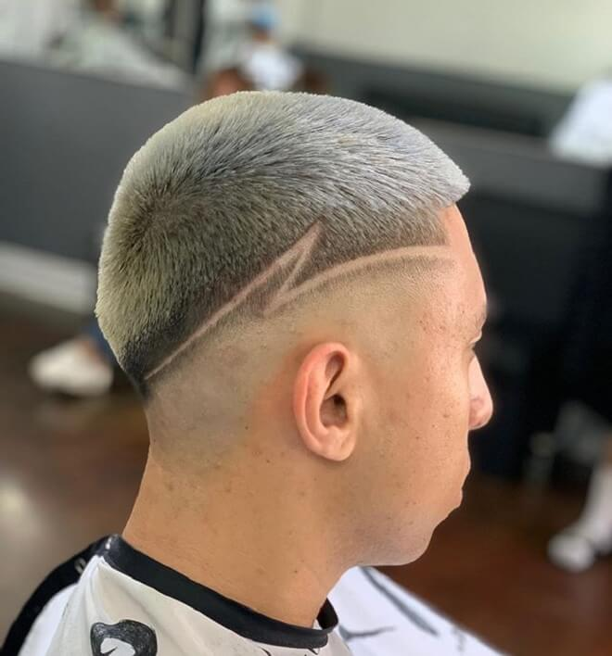


Hair, Makeup and Jewelry
Notes:
Andrew

Slide 19

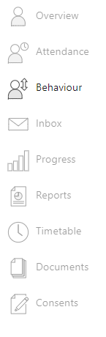
How to view behaviour points
To find out more detail for each point, you need to log onto G4S and use the menu to select ‘Behaviour’
If you child has received an afterschool detention, you will receive a notification the day before.
Notes:
Andrew

Slide 20
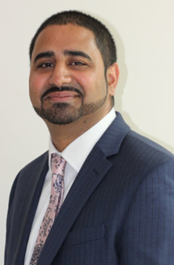
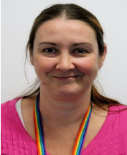
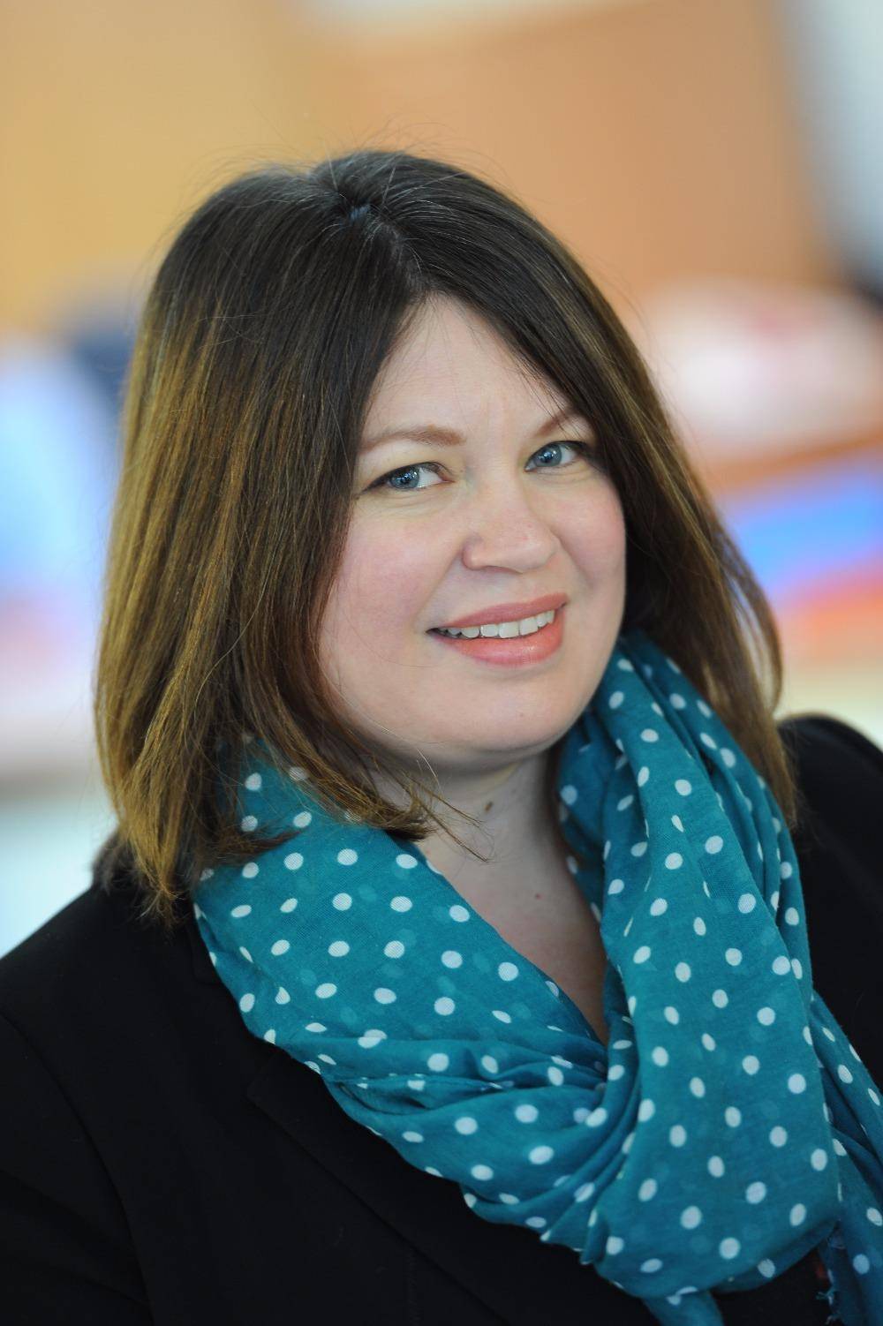
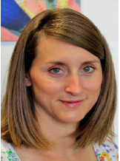
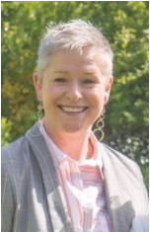
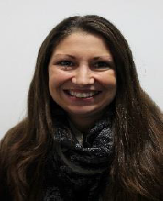
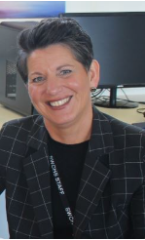
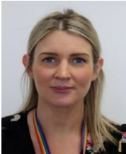
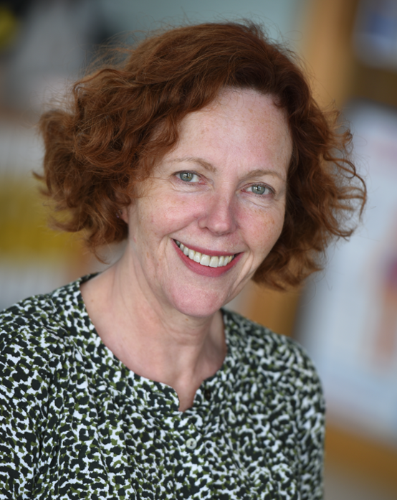
The Safeguarding Team
Paul Singh, Designated Safeguarding Lead (DSL) and PREVENT Lead
Sharon McCormick, Deputy Designated Safeguarding Lead (DDSL), Domestic Abuse lead, and CE Lead
Katie Vanderepere-Brown, Safeguarding Team Online Safety Lead
Katie Pieri, Safeguarding Team and CIC Lead
Beth Robertson, Safeguarding Team and Lead Counsellor
Jo Chapman, Safeguarding Officer for Sixth Form
Safeguarding Trained:
If you cannot get hold of any of the Safeguarding Team, then Polly Lankester, Amy Kennedy and Phil heath are also Level 3 Safeguarding trained.
Anna Moorhouse, Designated Mental Health and Wellbeing Lead
Anna Bendall, Safeguarding Sixth Form
Lucinda Bell
Safeguarding Governor
Notes:
Andrew

Slide 21
Careers and Future Aspirations at SWCHS
In Year 11, our careers provision is focussed on preparing for the future. To support students, they will be entitled to the following:
1:1 Careers Advice Discussion by Christmas
Access to Uttlesford Careers Fair 18th November
Guidance Discussion with parent
Access to Careers Library & Labour Market Information via Unifrog
In PSHE lessons, students will study the following:
  Pathways and qualifications
  Applying for a part-time job
  How to find an apprenticeship
  Preparing for interviews
  Universities
Notes:
Andrew

Slide 22
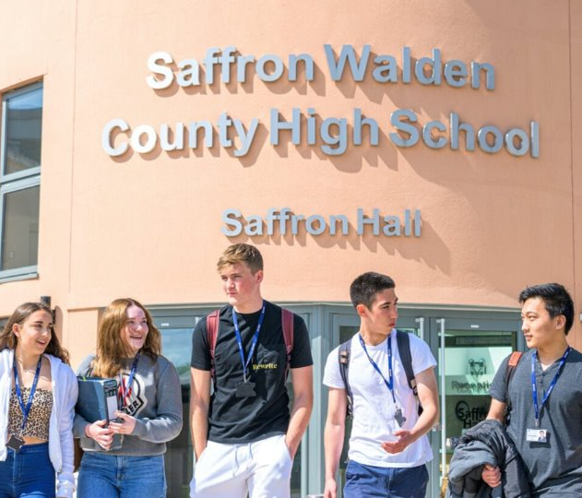
6th Form: Admissions
We received 648 applications
364 students are now enrolled:
256 students are from SWCHS
108 students are from 26 different schools
Notes:
Amy

Slide 23
3 Types of SWCHS responses:
Where students meet eligibility and demonstrate good commitment to their studies, they receive a priority offer
Where there are concerns regarding academic commitment, students might be made a ‘deferred’ offer
If students are not suitable for their chosen courses and do not meet the academic requirements, they may receive no offer.
Students from SWCHS do get treated more preferably than other local applications
Notes:
Amy

Slide 24
A Level Results
Nationally, 9.4% achieved an A* and 28.2% achieved an A*-A grade. ​
Here at SWCHS: ​
- Over 100 grades were awarded at A* Level​
- 44% of students achieved at least 1 A or A* grade.
Grades​ | Results 2024​ (274 students)​ | Actual 2025​ (277 students)​
A*​ | 11%​ | 14%​
A*-A​ | 34%​ | 34%​
A*-B​ | 64%​ | 68%​
A*-C​ | 87%​ | 88%​
A*-D​ | 97%​ | 97%​
A*-E​ | 99%​ | 100%​
Notes:
Amy

Slide 25
Grades​ DOUBLE AWARDS​ | Results 2024​ (68 students)​ | Actual 2025​ (70 students)​
D*D*​ | 8%​ | 21%​
D*D​ | 24%​ | 36%​
DD​ | 32%​ | 50%​
DM​ | 52%​ | 64%​
MM​ | 76%​ | 86%​
MP​ | 88%​ | 96%​
PP​ | 92%​ | 100%​
Grades - SINGLE AWARD​
D*​ | 9%​ | ​17%​
D​ | 44%​ | 48%​
M​ | 79%​ | ​86%​
P​ | 97%​ | 100%​
Notes:
Amy

Slide 26







Notes:
Amy

Slide 27
University Choices
Over 190 students received their First Choice University
Some rejected their First Choice in favour of other places (Clearing)
15 students are going to UEA
13 students are going to Loughborough, York
12 students are going to Exeter
10 students are going to Durham
6 students are going to Oxford
2 students are going to Cambridge (2 students turned down their place)
Notes:
Amy

Slide 28
Final Advice
All students will need to make an application
Start researching and applying now
You can make multiple applications
SWCHS Sixth Form will be a fresh start and a new experience for all students – we want it to feel different!
Notes:
Amy

Slide 29



SWCHS Fundraising
Notes:
Lauren

Slide 30
Rooms for the next session
Upstairs on D Corridor
D4 – 11JRS Mr Simmons
D5 – 11JXD Mr Duddy
D6 – 11LXH Mrs Hayes
D7 –11PSF Mr Facer
D9 – 11NAC Mr Chamberlain
Downstairs on B corridor
B2 - 11IDC Mr Clark
B4 –11GRM Mr Marshall
B7 - 11RMH Mr Hancock
B11 – 11SXL Mrs Rawlings and Miss Lock
B12 – Miss Bates
Notes:
Lauren – ask site

