Slide 1

Welcome

Slide 2
Tutor Name
I am your first point of contact at SWCHS. I see your child every day!
Please get in touch with me if you have any questions or concerns regarding your child.
I can then triage to the correct person if needed.
My email is rhancock@swchs.net

Slide 3
Our Pastoral Curriculum
Monday – Assembly
Tuesday –Year 11 notices
Friday – Tutor choice
Thursday – Reading
Wednesday – Student Voice and current affairs

Slide 4
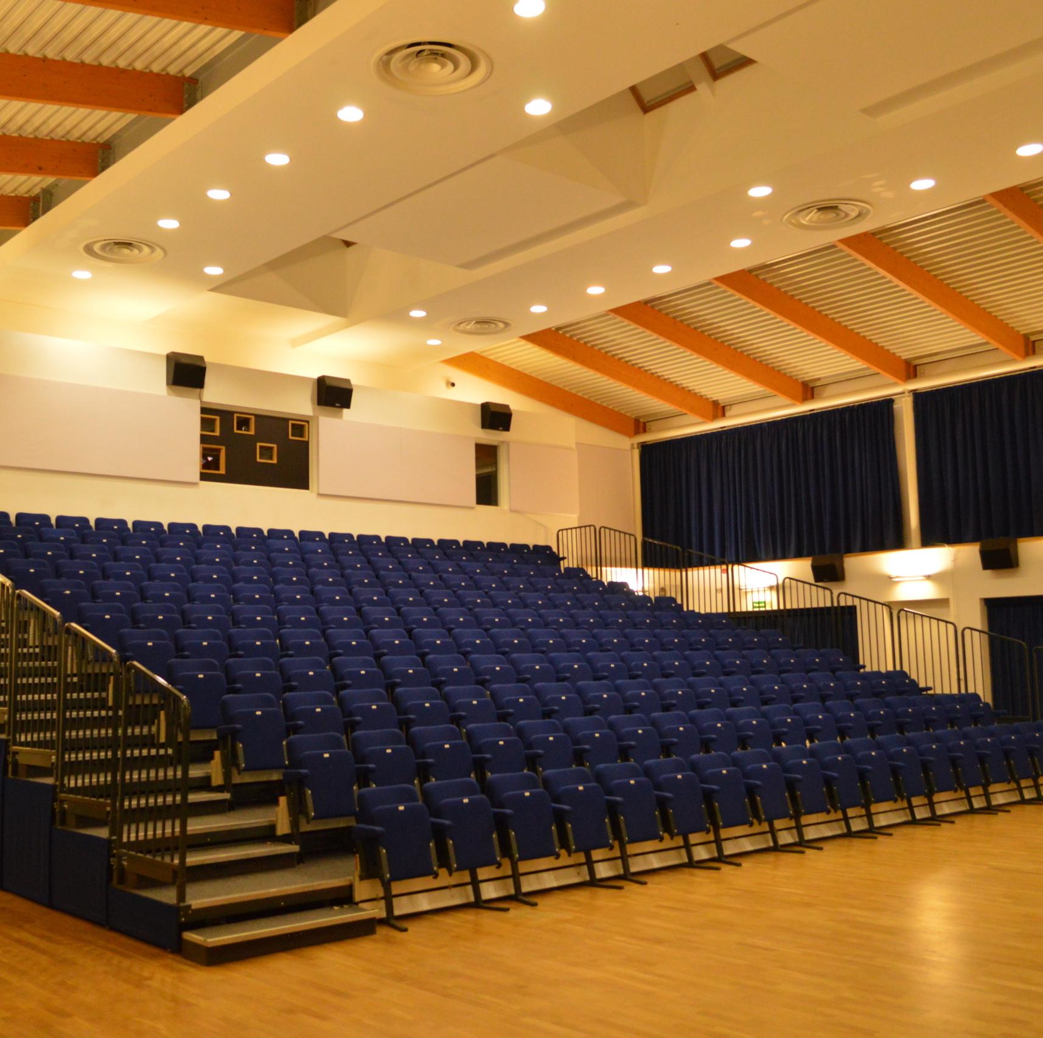
Monday
Assembly
As well as assemblies on important cultural topics and values, assemblies will also focus on key Year 11 themes such as managing exam stress, post-16 options, and optimal revision strategies

Slide 5

Tuesday
Year 11 specific notices - e.g. college application deadlines
Revision

Slide 6

Wednesday
Current Affairs
Student Voice discussions

Slide 7

Thursday
Reading as a class
We are continuing from last year and are reading is Dry by Jarrod and Neal Shusterman.

Slide 8

Friday
Tutor Choice!

Slide 9
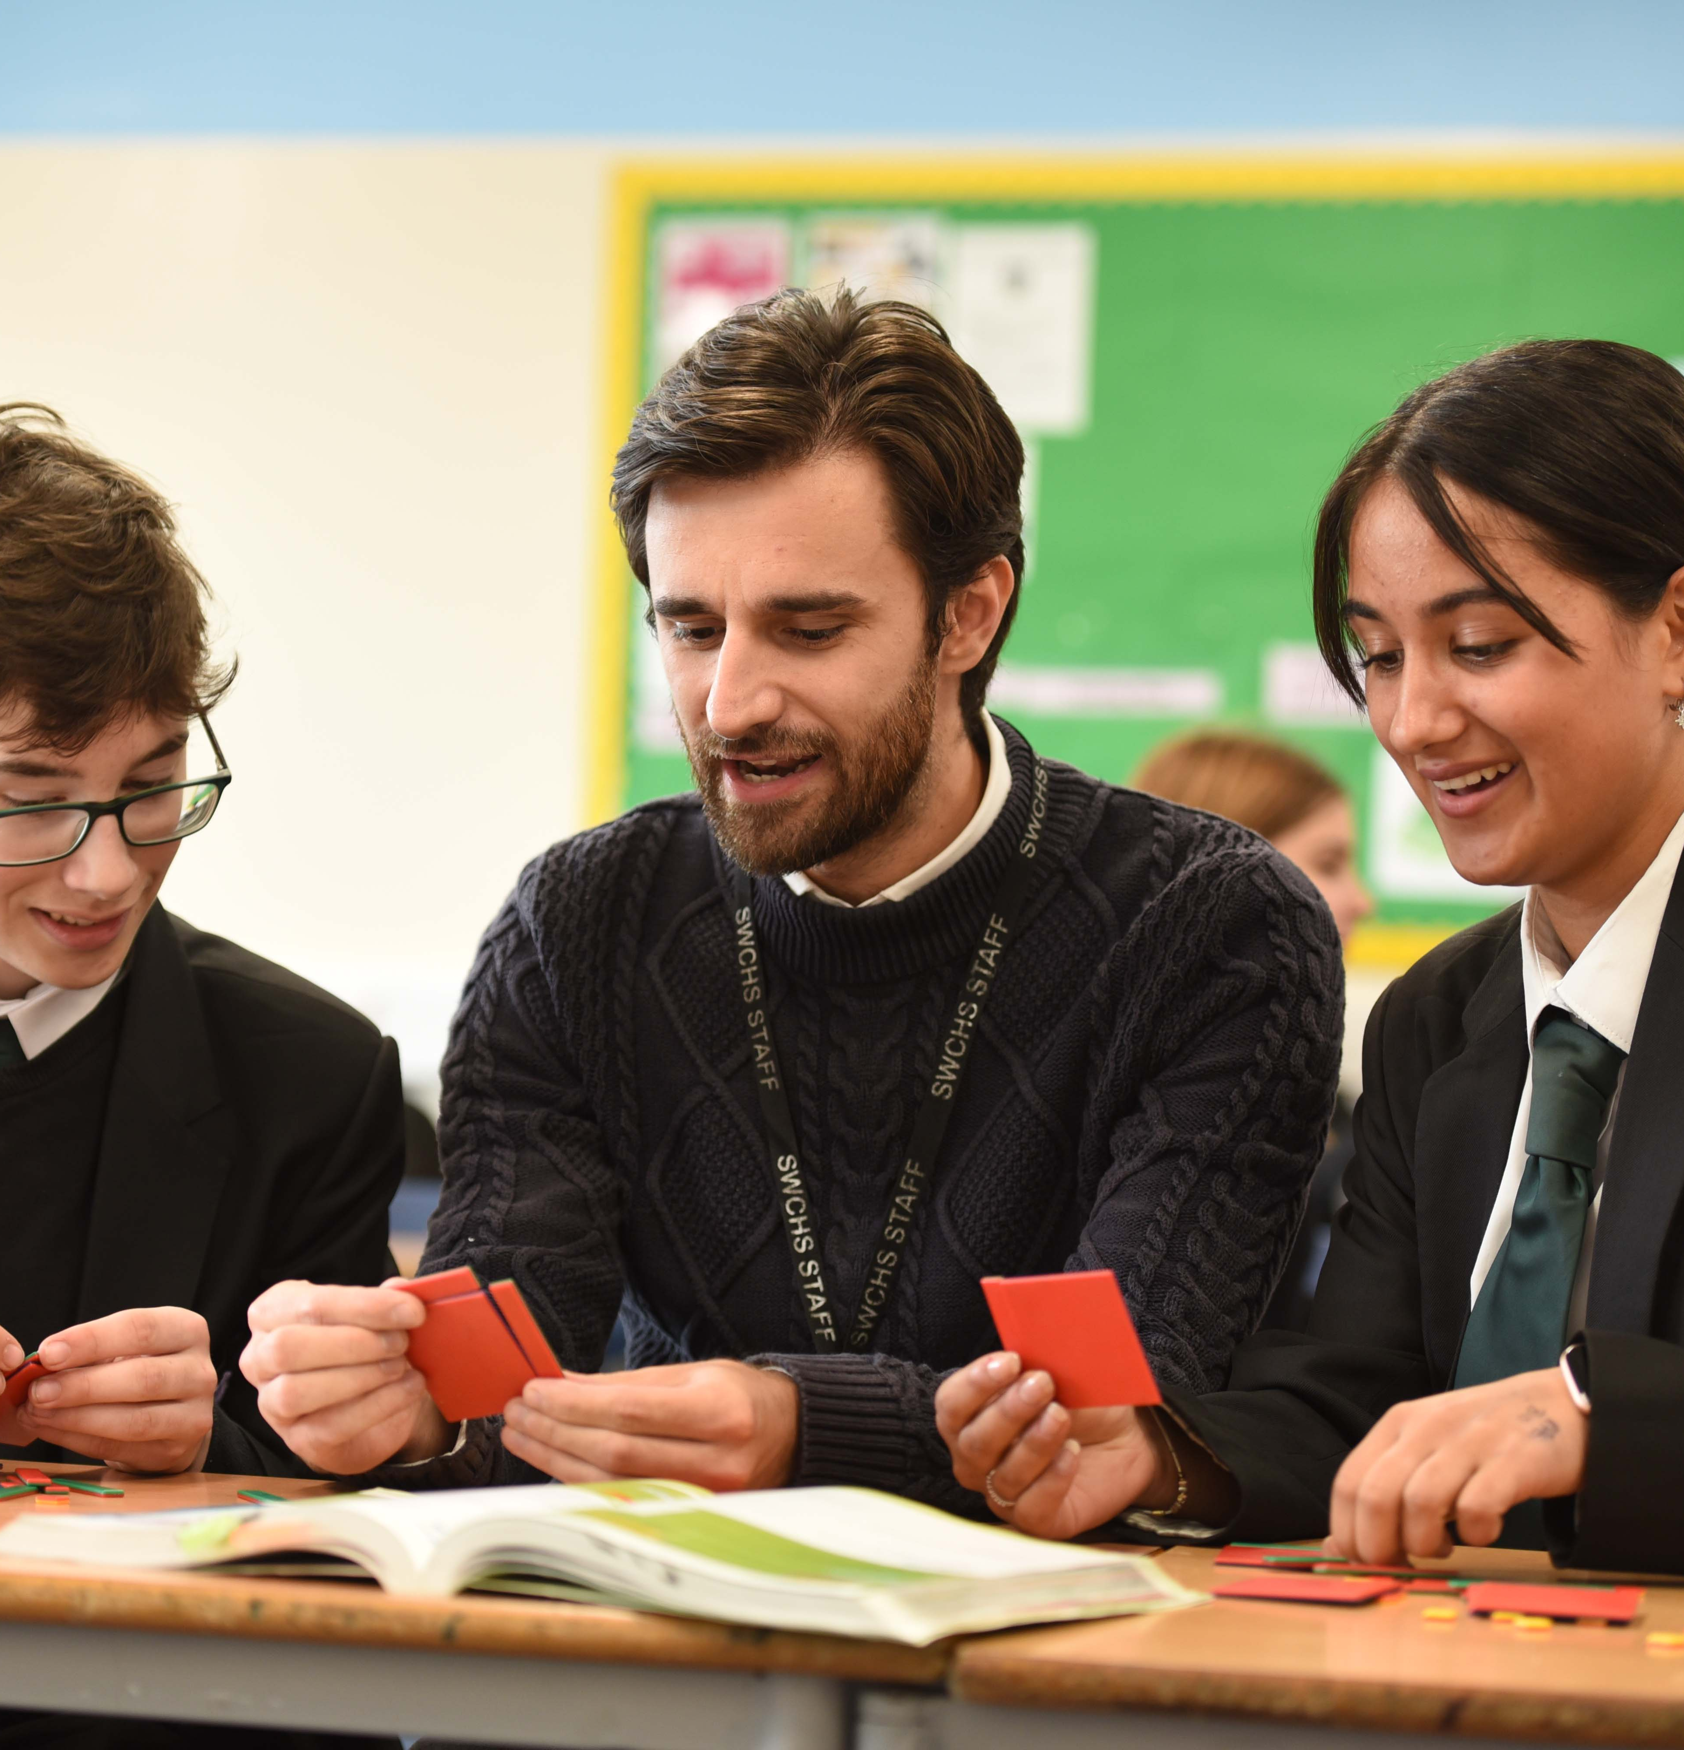
Tutorials
As we do not want to take students out of lessons in Year 11, tutors will not be carrying out tutorials in the same way as previous years
However if there are concerns, we will still pick students up 1-1 if needed
We will catch up with tutees during form times

Slide 10
How can I help my child revise?
Provide a quiet space for them to work at home
Help them to design a sensible revision timetable
Offer to test them on revision that they have done – sometimes students spend hours making flashcards or mind-maps but these are only useful if they use them effectively afterwards – testing students on their notes is a good way to avoid this.
Ask them to teach you about a topic they have revised
Encourage students to complete the revision activities teachers set (instead of doing their own thing!)
Remind students to revise question technique as well as content
Encourage them to take breaks!
Encourage students to attend any interventions or revision sessions

Slide 11
Useful revision resources
Online platforms such as Dr Frost, Seneca and Educake
Using revision guides to make notes
Making flashcards
Practice past questions and papers
Birmingham City University has a great page on revision techniques
It also includes information on how to revise with ADHD and dyslexia
https://www.bcu.ac.uk/exams-and-revision/best-ways-to-revise/best-revision-techniques

Slide 12

Subject specific advice

Slide 13
English Language and Literature.
Everything you need to know…
For English, students are awarded two separate grades: English Language and English Literature.
Students sit two papers in each qualification.
This is 100% examination; there are no controlled assessments.
There are no tiers of entry; all students will sit the same paper.
Literature exams are closed book-students need to learn key quotations
English Year 10 | English Year 11
Literature: Lord of the Flies/ An Inspector Calls Literature: Macbeth Literature: Poetry Language Paper 1: Reading and Writing fiction texts. Language Paper 2: Writing non-fiction texts Spoken Language Endorsement | Literature: A Christmas Carol/ Frankenstein Unseen poetry Language Paper 2: Reading non-fiction texts Revision: Language and Literature
This is how the course is divided between Year 10 and Year 11.

Slide 14






How can you support your child in English?
Talk to them about the texts they are studying – discussing texts out loud helps knowledge to stick.
Encourage students to use Educake as a revision resource. The sooner they start revising, the better.
Direct students to Mr Bruff on YouTube. He has lots of useful tutorials.
Direct them to their revision guides – we send letters out about purchasing these.
Help them to learn the new vocabulary we have taught.
Direct them to Seneca Learning
Students can sign up and access the revision materials for AQA GCSE Literature and Language.
Please remind them not to revise texts they haven’t studied with us, as there are other options on there!
Encourage them to come and talk to us and give us practice essays to mark. We want to help!
Test students on their quotations from their texts. Allow students to stick key quotations around the house!

Slide 15
Mathematics
1. Next Steps 2. Tiering 3. Revision
Exam board is Ed-Excel

Slide 16
Mathematics
1. Next Steps 2. Tiering 3. Revision
What GCSE Maths grade does your child need for 6th form options?
Maths
Grade 7
Further Maths
Grade 8
Core Maths
Grade 4
(5 recommended)
Core Maths is equivalent to half an A-level
Focus on financial and practical applications
Supports A-levels such as Economics, Biology, Psychology
Biology
Grade 6
(7 recommended)
Chemistry
Grade 6
(7 recommended)
Physics
Grade 7
Computer Science
Grade 7
(or 6 with 7 in CS)
Economics
Grade 6
Psychology
Grade 5
Business
Grade 5
Product Design
Grade 5
Retakes
for all students below Grade 4
The government requires all students who don’t achieve a Grade 4 or above in Year 11 to study eight hours of maths per fortnight until they have a Grade 4 pass.
Grades from 2025 SWCHS prospectus

Slide 17
Mathematics
1. Next Steps 2. Tiering 3. Revision
There are two tiers
Foundation (Grades 1 to 5, so up to a ‘low B’ in old money)
Higher (Grades 5 to 9, where 8 and 9 are the old A*)
We will enter students for Higher tier unless the evidence from the classwork and assessments suggests there is a danger they will not pass at this level.
Start of Year 11
Every student with a chance of being successful at Higher tier is in a Higher class
November Mocks
Two 1-hour papers based on key topics
Final tiering decisions
Based on classwork, assignments and November mocks
January Mocks
Two full-length GCSE papers. (No questions on topics not yet studied)
Tiering tweaks
Usually a very small handful of students who are in danger of not passing at Higher
(NB: Further Maths GCSE mocks run to a different schedule. We will send this information via ParentMail.)

Slide 18
Mathematics
1. Next Steps 2. Tiering 3. Revision
Revision homework
There will be revision homework leading up to the November mock.
Revision guides will be available on Wisepay shortly. Please order by 30 Sept
Fingertip Facts
Designed to help them test themselves on key facts and help with homework.
Replacements can be purchased on Wisepay if needed
After-school sessions
Past paper workshop open to all in Q1 from Tuesday 16 September.
Some students will be invited to targeted revision sessions.
After the mocks
Students receive a question-by-question analysis of where to close the gaps.
They will receive another set of revision homeworks between Nov & Jan mocks.
We issue past papers for homework from January onwards.
How to help your child revise
Encourage active revision: memorising facts, practising and MARKING questions.
Support Practice Paper work: exam conditions at home for past paper homeworks in Spring Term

Slide 19
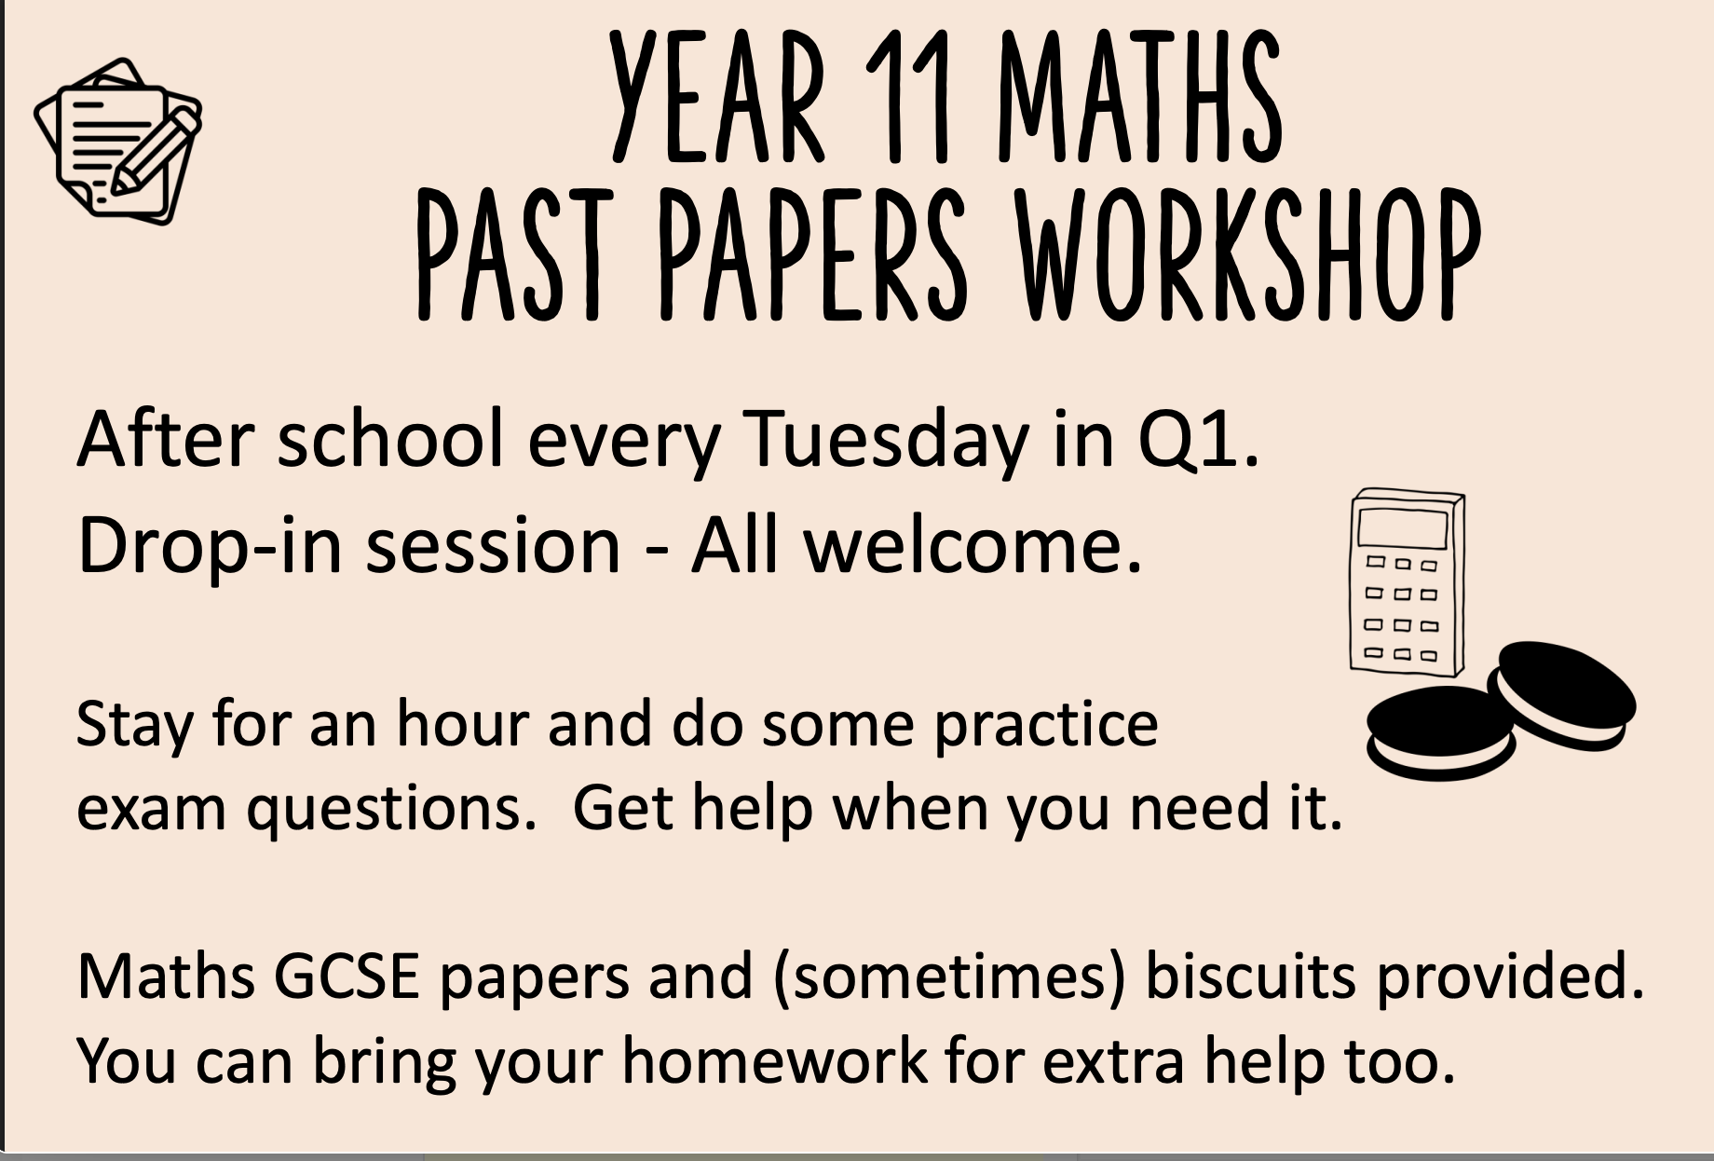

Slide 20
Science
Dr M Gwyer
mgwyer@swchs.net
Director of Science

Slide 21
Why Science is Important
Science qualifications are highly respected and prepare students for
Science, Health, Engineering and related industries (which are thriving!)
Many other courses and careers due to the extensive knowledge and skill base

Slide 22











Just a few local employers who use science

Slide 23

Science Qualifications

Slide 24
TRIPLE Science
Working towards three separate GCSEs in:
Biology
Chemistry
Physics
Summer exams: 2 x 1h45m papers in each subject
Mocks: Students will sit Paper 1 in each science in either November or January (order tbc)

Slide 25
Combined Science
Working towards 2 GCSEs built from biology, chemistry and physics topics
Summer exams: 2 x 1h10m papers in each subject (6 in total)
(2 x biology, 2 x chemistry and 2 x physics)
November mocks: 3 x 1h papers (from Year 10 and Autumn term Year 11)
January mocks: 3 x shorter papers (from Year 10 and Autumn term Year 11)

Slide 26
Combined Science – Which Tier?
ALL HIGHER PAPERS
9/9 | 9/8 | 8/8 | 8/7 | 7/7 | 7/6 | 6/6 | 6/5 | 5/5 | 5/4 | 4/4
 |  |  |  |  |  |  |  | 5/5 | 5/4 | 4/4 | 4/3 | 3/3 | 3/2 | 2/2 | 2/1 | 1/1
ALL FOUNDATION PAPERS

Slide 27
Combined Science – Which Tier?
Tier must be the same for all 3 sciences
ALL HIGHER PAPERS
9/9 | 9/8 | 8/8 | 8/7 | 7/7 | 7/6 | 6/6 | 6/5 | 5/5 | 5/4 | 4/4
 |  |  |  |  |  |  |  | 5/5 | 5/4 | 4/4 | 4/3 | 3/3 | 3/2 | 2/2 | 2/1 | 1/1
Final decisions to be made after January mocks.
Students are in science classes with students who are likely to do the same tier but this is constantly being reviewed
ALL FOUNDATION PAPERS

Slide 28
Entry Level Science
Taught alongside Combined Science for some students working up to Grade 3 or 4
More “chunked approach assessed by small in-class tests
Internally assessed

Slide 29






Preparation and support at home
Use lesson time...this is key!!!!! Our curriculum design builds in revision time. Focus in lessons is essential
Targetted revision sessions will be held later in the year
Fuse School

Slide 30
Preparation and support at home
Use lesson time...this is key!!!!! Our curriculum design builds in revision time. Focus in lessons is essential
Targetted revision sessions will be held later in the year
Strongly recommend purchasing revision guides
Fuse School

Slide 31
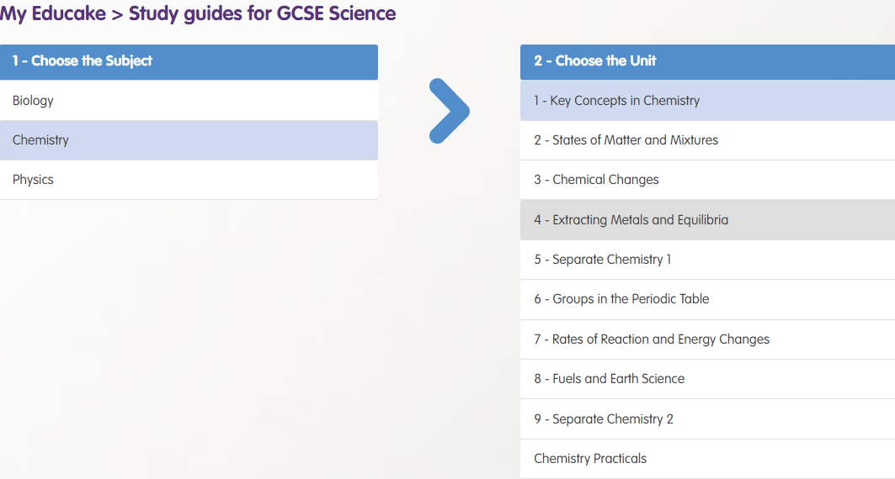
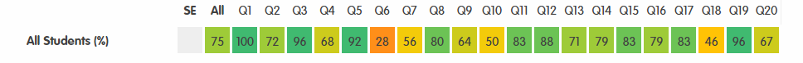
Educake
Teacher-set homework
Teacher-set mock revision
Independent revision
Teachers will select and set Educakes after mocks based on performance.
Please support with log-in / checking / encouraging students to use resources and links and to resit quizzes

Slide 32

Teams
All homework is set on Teams.
Please check your child’s teams regularly to ensure they are keeping on top of their homework .
Homework club runs Monday –Thursday afterschool until 4.30 and Friday until 4pm. Teachers and support staff are on hand to help students with their homework.

Slide 33
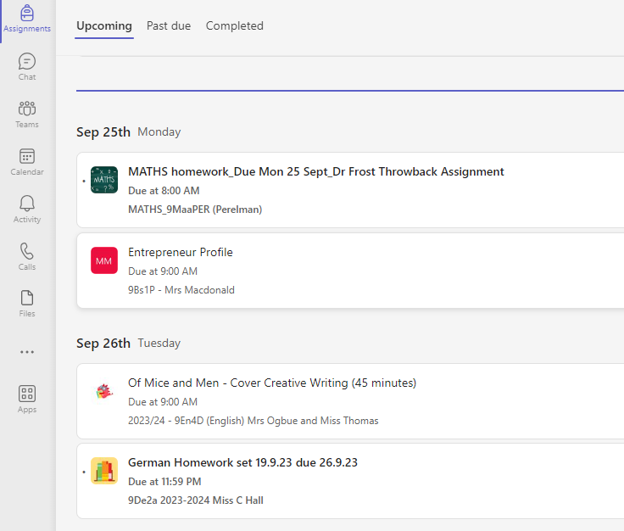
How to monitor your child's Teams account
Student's teams accounts normally open straight onto assignments, but click the Assignments button in the left column if it doesn't
In the Upcoming section, you can see all the homework which is due for your child.
The Past due column shows any deadlines, your child has missed and needs to catch up on

Slide 34
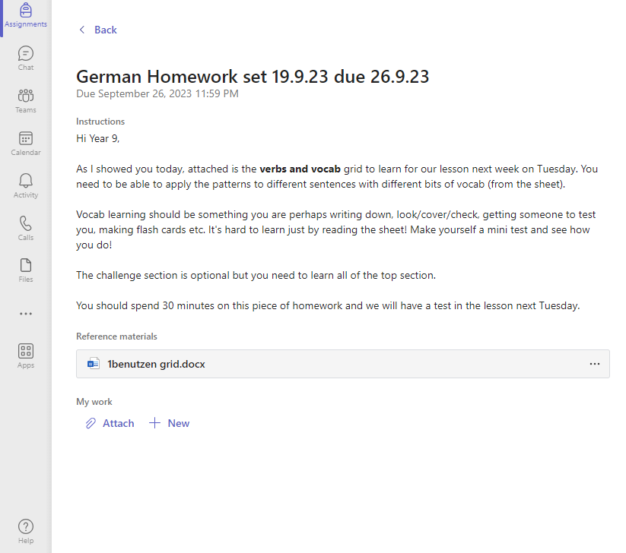
When students click on an individual assignment, it will take them to their homework.
Any resources they need to complete the homework will be attached and teachers should also indicate long the piece should take.

Slide 35

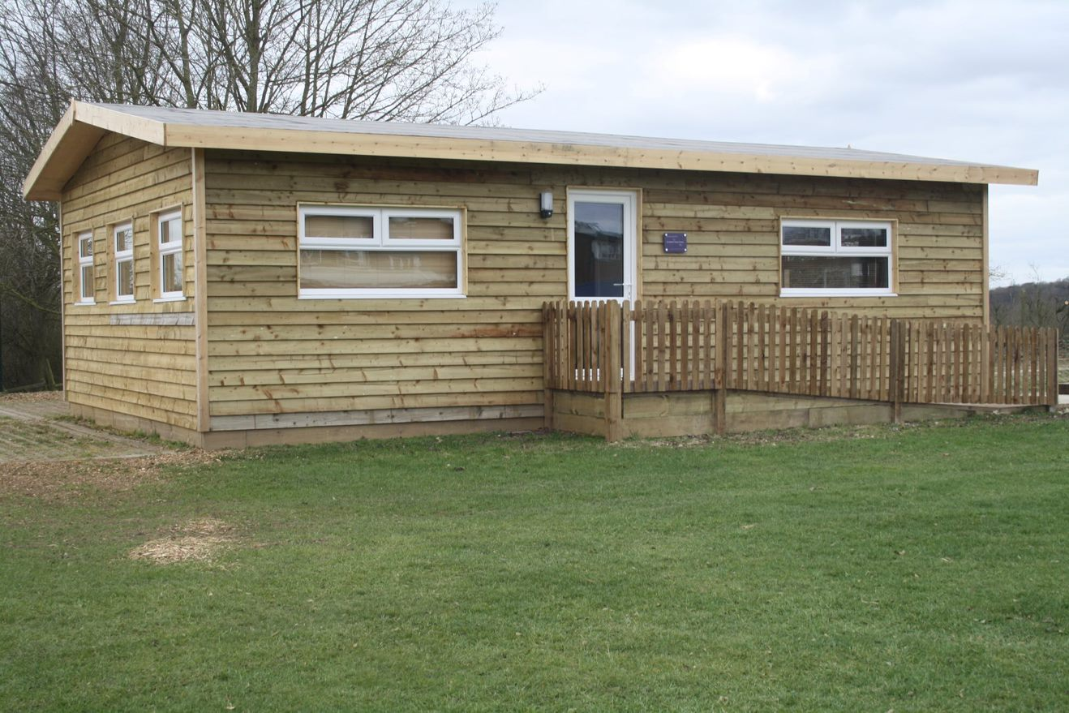
Further support
We are very lucky to have access to a range of counselling services in school for students. This is co-ordinated through the Wellbeing Hub who run group and individual sessions.
If you feel your child needs further wellbeing support, please do speak to your child's form tutor. Please be aware that there is a waiting list.
For support outside of school Open Door is a brilliant local service based in Saffron Walden.

Slide 36
Q&A
Please feel free to ask any general questions.
Alternatively, please stay behind and ask any questions.
Thank You

